Slide 1
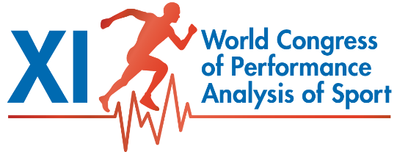




Medal-winning Enhancements of Performance
16-18 Nov 2016 – Alicante, Spain
Will Hopkins
Institute of Sport Exercise and Active Living, Victoria University, Melbourne
High Performance Sport NZ, Auckland
Defence Institute, NIH, Oslo
will@clear.net.nz – sportsci.org/will
Enhancements in non-interactive sports (track and field, rowing…)
  Within-athlete variability in performance scores between competitions
Enhancements in interactive non-match sports (road cycling…)
  Within-athlete variability of competition rank
Enhancements in match-play sports (team and court sports, fights…)
  Chances of winning the medal match

Slide 2
Enhancements in Non-interactive Sports (track & field, rowing...)
Hopkins WG, Hawley JA, Burke LM (1999). Design and analysis of research on sport performance enhancement. Medicine & Science in Sports & Exercise 31, 472-485
Hopkins WG, Marshall SW, Batterham AM, Hanin J (2009). Progressive statistics for studies in sports medicine and exercise science. Medicine & Science in Sports & Exercise 41, 3-12
We suggested an enhancement that results in one extra medal per 10 competitions is the smallest important effect for a top athlete.
You can’t use competitions directly to study strategies or factors having this sort of effect.
  Coaches are usually unwilling to try new strategies in competitions.
  You’d need to investigate too many competitions for adequate precision of changes in the small proportion of wins between competitions.
But you can study the times, distances or other performance scores that produce medal-winning performances.
  You can measure most scores or related measures in lab or field tests.
  Numbers of tests and/or athletes for adequate precision are still large, but adequate precision is often achievable.

Slide 3
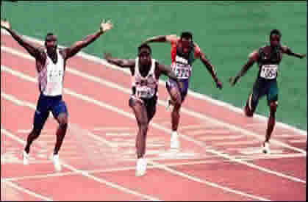
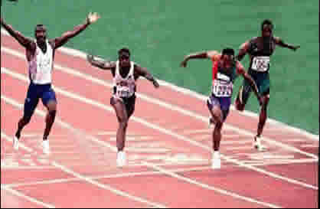
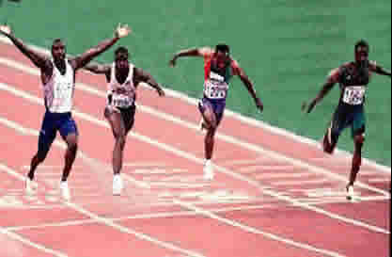
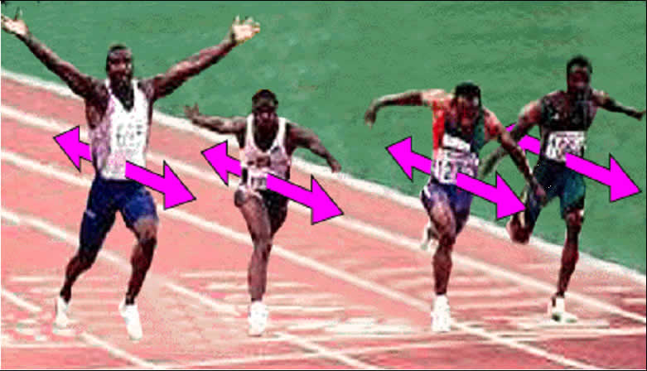
So, what’s needed is the enhancement of time or distance that results in one extra medal per 10 competitions for a top athlete.
The within-athlete variability that athletes show from one competition to the next determines the value of the enhancement. Here's why…
  Owing to this variability, each of the handful of top athletes has a good chance of winning at each competition:
  If you think of the typical variability in each
  athlete’s performance as a distance or time…
  Then it’s obvious that your athlete needs an
  enhancement that overcomes this variability
  to win more medals on average.
Race 1
Race 2
Race 3

Slide 4
Simulations showed that an enhancement of 0.3× an athlete's typical variability gives one extra medal every 10 competitions.
  Example: top runners vary by ~±1% from competition to competition, so an improvement of 0.3% would take an athlete from 4 medals to 5 medals every 10 races.
So, the error of measurement or “noise” in competitive performance
is ~3× the smallest important enhancement or “signal”.
  Competitive performance is therefore fundamentally noisy or unreliable!
  Hence you need lots of repeated performances, tests and/or athletes to track meaningful changes in individuals and in studies with samples.
  As always, larger effects need smaller sample sizes.
Moderate, large, very large and extremely large effects result in 3, 5, 7 and 9 extra medals in every 10 competitions.
  Simulations provided the corresponding enhancements:
  0.9×, 1.6×, 2.5× and 4.0× the variability.
Knowing and understanding the variability is important…

Slide 5













Malcata RM, Hopkins WG (2014). Variability of competitive performance of elite athletes: a systematic review. Sports Medicine 44, 1763-74. Plus several recent studies.
Percent variability (CV) of top athletes was derived via mixed-model “reliability” analyses of log of time, distance or weight.
running ≤1500 m:
0.8%
track cycling time trial:
1.0%
running ≤10 km:
1.1%
road cycling time trial:
1.5%
field events:
~2%
mountain biking:
2.4%
weightlifting (men):
1.7%
swimming:
0.8%
weightlifting (women):
3.3%
Paralympic swimming:
2.0%
triathlon:
1.1%
skeleton:
0.4%
rowing:
0.9%
sprint speed skating:
0.4%
canoe/kayak sprint:
1.0%
endurance speed skating:
0.6%
canoe slalom (not penalized):
1.4%
alpine skiing:
0.6%
canoe slalom (penalized):
1.7%
cross-country skiing:
0.7%

Slide 6
The differences in variability can be explained by different contributions of comp-to-comp variation in power output, skill, pacing, pack racing, environmental perturbations, and especially kinetics.
  Example: in running and cross-country skiing, the variability in time (0.8% and 0.7%) is likely due mainly to variability in power output.
  In these sports, a 1% change in power produces a 1% change in time.
  Any pack racing in these sports tends to reduce the apparent variability, so the variability in a top athlete’s power output is at most ~1.0%.
  This variability will likely apply to any top high-performance athlete…
  …including time-trial cyclists. But these athletes develop power against mainly wind resistance, and the relationship between power and velocity is P = kV^{x}, where x = ~2.4 (or 3.0 for purely wind resistance).
  Hence (by calculus) the variability (%) in time-trial time should be 1/2.4x the variability in power = ~1.0/2.4 = ~0.4%.
  But we observe ~1.0%! The extra variability may come from changes in each cyclist’s overall riding position from race to race.
  A possible avenue for performance enhancement?

Slide 7
Implications for winning medals by increasing power output…
  The smallest important enhancement in competitive performance score is 0.3× the competition-to-competition variability in the score.
  Use a kinetic factor to convert this to a change in power output.
    Examples:
    the smallest important change in running is 0.3×0.8%×1 = ~0.2%,
    but in rowing it is 0.3×0.9%×3 = ~0.8%
When monitoring for such (and larger) changes, take into account the protocol of the test.
  Example: a 1% change in power output in a time trial is equivalent to:
    1% change in peak power in any incremental test;
    2% change in time to exhaustion if the incremental test starts at 50% of peak power;
    ~15% change in time to exhaustion in a constant-power test.

Slide 8
Enhancements in Interactive Non-match Sports (road cycling…)
Phillips KE, Hopkins WG (2017). Performance relationships in timed and mass-start events for elite Omnium cyclists. International Journal of Sports Physiology and Performance (in press). Plus earlier studies on athlete ranks with Rita Malcata.
In mass-start cycle races, interaction between cyclists in pack riding makes performance time a poor measure of performance.
Smallest and other important changes in performance cannot come from an analysis of race-to-race variability of time.
The only measure of performance available is the finish rank.
  Analysis of the raw rank is inappropriate, because it implies differences between 2nd and 1st, 10th and 9th, 100th and 99th… are all similar.
  Analysis of log of the rank implies differences between 2nd and 1st, 10th and 5th, 100th and 50th… are all similar, which is more realistic.
We used the track-cycling Omnium to investigate log rank as a measure of performance.
  The Omnium has three time-trial (non-interactive) events, three mass-start (interactive) events, and a finish rank.

Slide 9
The log of time in each non-interactive event was analyzed with the usual reliability model to estimate within-cyclist comp-to-comp variability (not an option for the interactive events and final rank):
The same analyses were performed for the log of rank.
  The apparently huge CVs for rank reflect large factor changes in rank from comp to comp: 109% = ×/÷2.09; that is, a cyclist with a true rank of 10th overall could easily come 5th or 20th in a given competition.
Data shown are for top-24 men.
Data for top-24 women are similar.
Time
CV (%)
Rank
CV (%)
flying lap
1.6
68
non-
interactive
individual pursuit
1.5
68
1-km time trial
1.4
67
points race
-
110
interactive
elimination race
-
94
scratch race
-
112
final rank
-
109

Slide 10
Both analyses produce estimates of between-cyclist CVs (not shown), which combine with the within-cyclist CVs to give intraclass correlation coefficients (ICC) representing comp-to-comp correlations.
  The similar ICCs for time and rank show that log of rank contains similar information about performance as the log of time.
  Log of rank can therefore be used to derive the smallest important change in rank: ÷2.09^{0.3} = ×0.80 = -20% (e.g., 10th to 8th).
  There are very interesting relationships between event and final ranks!
Time
CV (%)
Rank
CV (%)
Time
ICC
Rank
ICC
flying lap
1.6
68
0.73
0.62
non-
interactive
individual pursuit
1.5
68
0.59
0.65
1-km time trial
1.4
67
0.65
0.61
points race
-
110
-
0.32
interactive
elimination race
-
94
-
0.39
scratch race
-
112
-
0.12
final rank
-
109
-
0.23
Anyone can win!

Slide 11
Enhancements in Match-play Sports (team/court sports, fights…)
Higham DG, Hopkins WG, Pyne DB, Anson JM (2014). Performance indicators related to points scoring and winning in international rugby sevens. Journal of Sports Science and Medicine 13, 358-364.
Liu H, Hopkins WG, Gómez MA (2015). Modelling relationships between match events and match outcome in elite football. European Journal of Sport Science 16, 516-25.
Ultimately you want an enhancement that will increase your chances of winning the gold-medal match or the bronze-medal match.
As in non match-play sports, the smallest important enhancement would win 1 extra match in every 10 matches.
Moderate, large, very large and extremely large enhancements would give 3, 5, 7 and 9 extra wins in every 10 matches.
But strategies or factors producing such enhancements would apply to earlier matches in the tournament or season.
And there are often enough matches to provide reasonable precision for effects of such strategies and factors.

Slide 12


So you can (and you have to) study actual competitions.
  Analyze effects with repeated-measures logistic regression.
  Express linear predictors as odds ratios per 2 within-team SD.
  Convert odds ratios to differences in chances of winning a close match.
  Example: odds ratio =1.5 is equivalent to 55% - 45% = 10%.
  Allow for different effects in close vs runaway loss/win matches.
Examples in international rugby 7s:
    Passes per minute of possession reduce the chances of winning by 15% (90% confidence interval 7% to 23%; trivial-small).
    Line-outs retained change chances by 4% (-8 to 16%; trivial-small).
    Possession time increases chances by 17% (8 to 26%; trivial-small).
Examples in elite football:
    Possession time reduces chances by 12% (3 to 21%; trivial-small).
    Yellow card changes chances by 3% (-7 to 13%; trivial-small).
    Home game increases chances by 20% (10 to 30%; small-moderate).
  These effects are for team performance indicators. The Holy Grail is an analysis of effects of individual player indicators on team performance.

Slide 13
Conclusions
Study non-interactive sports in the lab, field or competitions.
  Threshold enhancements for winning medals come from fractions and multiples of the variability top athletes show in competitions.
  Be careful when translating changes in performance in tests into medal-winning changes in performance in competitions.
Study interactive non-match sports only in competitions.
  Assess factors and strategies affecting performance via analysis of the log of the athletes’ ranks.
  Use the same approach to study final rank in multi-event sports and to study factors affecting world ranking.
  There may be better transformations of the rank than simply the log.
    We are investigating log of the rank expressed as a proportion, using over-dispersed repeated-measures logistic regression.
Study match-play sports only in competitions.
  Analyze differences in chances of winning via logistic regression.
  Follow the quest for the Holy Grail: effects of players on team winning.

