Slide 1
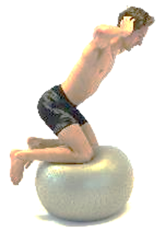
Effects of core-stability training on performance
and injury in competitive athletes
Thomas Haugen, Lars Haugvad & Vibeke Røstad
Norwegian Olympic Federation
2016
Notes:
As conditioning experts and physiotherapists at the Norwegian Olympic Training Centre, the present authors have observed that core training is a part of the overall conditioning program in the vast majority of competitive athletes, regardless of sport disciplines. Is there sufficient evidence to support this practice? The overall objective of this presentation is three fold: 1) to provide a critical overview of scientific studies exploring the relationship between core stability and athletic performance, injury prevention and injury rehabilitation, 2) identify methodological limitations and concerns associated with these investigations, and 3) outline specific training/rehabilitation recommendations. Hopefully, this presentation can contribute to improve best practice regarding conditioning and rehabilitation of performance-oriented athletes.

Slide 2
Content
Slide
Definitions 3
Core stability and balance 7
What contributes to core stability? 9
Assessing core stability 12
Functional movement screening (FMS) 19
Future core stability monitoring? 21
Training recommendations 22
Core stability and athlete performance 28
Do deficits in core stability increase the injury risk? 31
Does core stability training prevent injuries? 34
Does core stability training enhance injury recovery time? 36
Conclusions 38
Perspectives 39

Slide 3
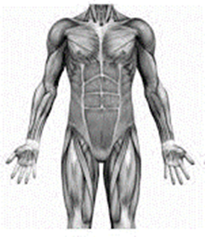
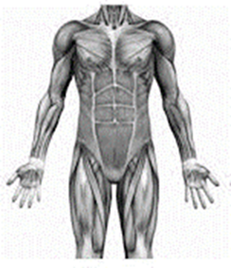
Definitions
What is the core?
The area between the diaphragm and
the pelvic floor?
The area between the sternum and the knees?
No consensus, definitions depend on the context
Notes:
Anatomical definitions and delimitations of the core vary across studies. Here are some examples :
Richardson et al., 1999 and Akuthota & Nadler, 2004: The core is a box or double-walled cylinder with the abdominals in the front, paraspinals and gluteals in the back, the diaphragm as the roof and the pelvic floor and hip girdle muscles as the bottom level.
Willson et al., 2005: The core is the lumbo-pelvic hip complex, consisting of the lumbar spine, pelvis, and hip joints, and the active and passive tissues that produce or restrict motion of these segments.
Zazulak et al., 2007^{B}: The core of the body includes the structures of the thoracolumbar spine and pelvis and the contributions of the trunk musculature.
Kibler et al. 2006: The musculoskeletal core of the body includes the spine, hips and pelvis, abdominal structures and also the proximal lower limb. The core musculature includes the muscles from the trunk and pelvis
Fig (2005) includes all anatomy between the sternum and the knees, with a focus on the abdominal region, low back and hips.
Behm et al., 2010: The anatomical core is defined as the axial skeleton (which includes the pelvic girdle and shoulder girdles) and all soft tissues (i.e., articular and fibro-cartilage, ligaments, tendons, muscles, and fascia) with a proximal attachment originating on the axial skeleton, regardless of whether the soft tissue terminates on the axial or appendicular skeleton (upper and lower extremities).
The definitions vary according to the context in which they are viewed (e.g. rehabilitation vs. performance, elite sport vs. health care, etc.).

Slide 4
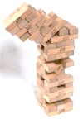
Definitions
What is stability?
Physicians are concerned about clinical stability
Physicists are concerned about mechanical stability
Notes:
The term “stability” is often interpreted differently by physicians and physicists. In mechanics, “stability” is the ability of a loaded structure to maintain static equilibrium even at fluctuations around the equilibrium position (Bergmark, 1989). For a physician, “stability” is associated with “clinical stability”, which according to White & Panjabi (1978) is the ability of the spine under physiologic loads to limit patterns of displacement so as not to damage or irritate the spinal cord or nerve roots and, in addition, to prevent incapacitating deformity or pain due to structural changes.” Clinical stability can be regarded as a continuously variable phenomenon, while mechanical stability is not (it is either stable or unstable, and the mechanical system will collapse when the compressive force exceeds a critical value) (Bergmark, 1989).

Slide 5
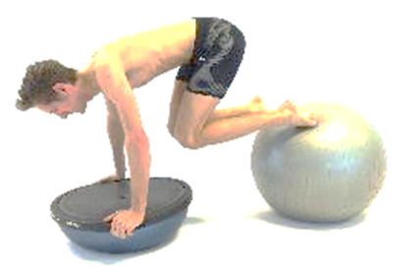
Definitions
What is core stability?
Numerous definitions exists, no consensus established
Definitions depend on the context
Notes:
In the research literature, several “core stability” definitions have been proposed:
Panjabi, 1992: “The integration of the passive spinal column, active spinal muscles, and the neural control unit, which when combined maintains the intervertebral range of motion within a safe limit to enable activities to be carried out during daily living.”
Leetun et al., 2004: “The product of motor control and muscular capacity of the lumbal-pelvic-hip complex.”
Liemohn et al., 2005: “The functional integration of the passive spinal column, active spinal muscles and a neural control unit in a manner that allows the individual to maintain the intervertebral neutral zones within physiological limits, while performing activities of daily living.”
Kibler et al., 2006 : ‘‘The ability to control the position and motion of the trunk over the pelvis and leg to allow optimum production, transfer and control of force and motion to the terminal segment in integrated kinetic chain activities.’’
Faries & Greenwood, 2007: “The ability to stabilize the spine as a result of muscle activity.”
Zazulak et al., 2007^{A and B}: “The body’s ability to maintain or resume an equilibrium position of the trunk after perturbation.”
Mendiguchia et al. (2011): The ability of passive and active stabilizers in the lumbal-pelvic region to maintain appropriate trunk and hip posture, balance and control during both static and dynamic movement.

Slide 6
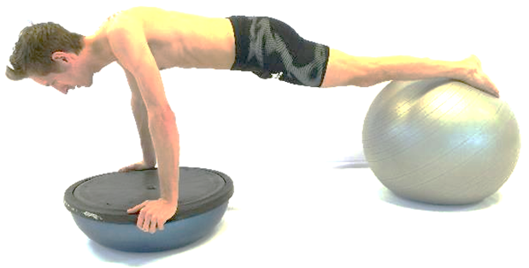
Definitions
What is core strength?
Several definitions also here, no consensus established
Again: definitions depend on the context
Notes:
Core strength definitions:
Akuthota & Nadler, 2004: “The muscular control required around the lumbar spine to maintain functional stability.”
Faries & Greenwood, 2007: “The ability of the musculature to produce force through contractile forces and intra-abdominal pressure.”
Reed et al., 2012: “The ability of the core muscles to generate and maintain force.”
Borghuis et al. (2008) claim that core strength is just one part of the core stability concept. However, core strength can also be viewed as an isolated variable to increase performance (Behm et al., 2010). The terms core stability and core strength are sometimes used interchangeably in the research literature, but we will stick to the term “core stability” further in this presentation.

Slide 7
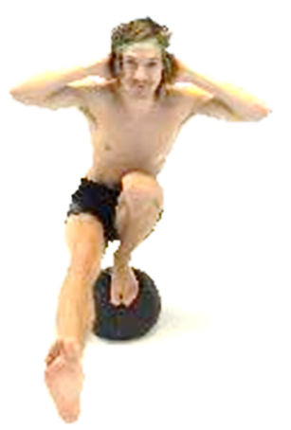
2. Core stability and balance
No clear relationship between core stability and balance performance
Increased trunk stiffness from muscle co-activation may impair postural control
Notes:
Balance is the ability to stay upright or stay in control of body movement. There are two types of balance: static and dynamic. Static balance is maintaining equilibrium when stationary, while dynamic balance is maintaining equilibrium when moving (Hrysomallis, 2007). Although some authors have indicated a certain relationship between balance performance and core stability (Radebold et al. 2001; Borghuis et al., 2008), this possible association has not been explored in competitive athletes. An increased active trunk stiffness from muscle co-activation has shown impaired postural control among recreationally active subjects (Reeves et al. 2006).

Slide 8
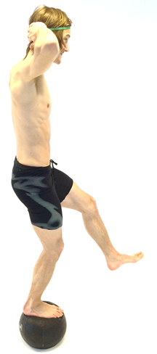
2. Core stability and balance
No clear relationship between core stability and balance performance
Increased trunk stiffness from muscle co-activation may impair postural control
Balance abilities distinguish athletes of varying performance level in some sports
Poor balance ability is an injury risk factor in several sports
Notes:
Gymnasts appear to have superior balance abilities (Hrysomallis, 2007). Cross-sectional studies have shown that balance abilities distinguish athletes of varying performance levels in rifle shooting (Mononen et al., 2007), soccer (Paillard & Noe, 2006; Paillard et al., 2006) and golf (Sell et al., 2007), but not in alpine skiing (Noe & Paillard, 2005), surfing (Chapman et al., 2008) and judo (Paillard et al., 2002). However, cross-sectional relationships do not necessary reveal a cause-effect relationship.
Poor balance ability has been associated with increased risk of ankle injury in several sports (Watson, 1999; Tropp et al., 1984; Hrysomallis et al., 2007; McGuine et al., 2000; Willems et al., 2005). Moreover, studies have shown that balance training, as part of a multifaceted intervention, reduce the number of ankle or knee injuries in team handball (Wedderkopp et al., 1999; Olsen et al., 2005; Myklebust et al., 2003) and volleyball players (Bahr et al., 1997). According to Hrysomallis (2007), balance training is more effective for injury prevention when performed as a part of a multifaceted intervention.

Slide 9
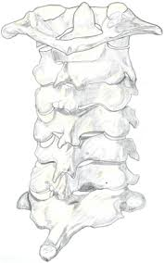
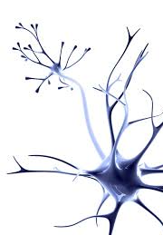

3. What contributes to core stability?
Anatomical structures
1. Skeleton bones, ligaments
and intervertebral discs
2. Muscles and tendons
3. Neural structures
Notes:
The contributors to spinal stability have been categorized into three groups: Passive (bones, ligaments and intervertebral discs), active (muscles and tendons) and neural structures (Panjabi, 1992; Akuthota & Nadler, 2004; Zazulak et al., 2007; Behm et al., 2010). Continuous interaction among all three subsystems ensures stability (Panjabi, 1992). The musculature is most important in maintaining spinal stability under various conditions (Ebenbichler et al., 2001). Thus, healthy subjects respond to conditions that threaten spinal stability by co-contraction of muscles. For example, core muscle activity precedes lower extremity muscle activity in most athletic tasks (e.g. intra-abdominal pressure creates a stabilizing corset, a proximal stability for distal mobility) (Putnam 1993; Hodges et al., 1997; Baechle et al. 2000; Ebenbichler et al. 2001; Hodges, 2003; Anderson & Behm 2005; Kibler et al., 2006). This behavior is triggered by information from the nerve system.
Bergmark (1989) categorized the involved muscles as «local» (attached to the vertebrae, influence inter-segmental control) and «global» (attached to the hips and pelvis, influence spinal orientation and external forces on the spine). However, Lederman (2010) stated that such a division of the trunk is a reductionist fantasy, which serves only to promote the «core-stability concept». He argued that the control of the trunk is whole, and that core muscles do not work independently from other trunk muscles during normal functional movement.

Slide 10

3. What contributes to core stability?
Physiological skills
Strength (least important)
Muscular endurance
Sensory-motor control (most important)
Notes:
Modest levels of muscle activity (5-25% of maximal voluntary contraction) provide sufficiently stiff and stable joints (Cresswell et al., 1994; Cholewicki et al., 1999; Cholewicki & McGill, 2001; Kibler et al., 2006). Thus, muscle strength is rarely a limiting factor for core stability in daily living tasks in healthy subjects (Comerford & Mottram, 2001). Muscular endurance (McGill, 1998; McGill, 2002; McGill et al. 2003; Anderson & Behm, 2005; Lehman, 2006) and particularly sensory-motor control (also termed neuromuscular control) (Borghuis et al., 2008; Silfies et al., 2015) are other important contributors to core stability.
Saeterbakken et al. (2015) observed no systematic correlations between core endurance, core strength or core stability, indicating that these capacities are largely independent of each other. Thus, practitioners must stimulate these skills accordingly based on the aim of the training.

Slide 11


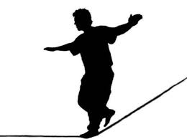
3. What contributes to core stability?
The neuromuscular control system
Actual body configuration
Sensory information
(joint positions, velocities, forces)
CNS:
Integration of sensory information, determination of motor command
Desired body configuration
Notes:
Sensory-motor control for core stability is a mechanism/strategy that involves the neuromuscular system to stabilize/regain optimal body configuration, similar to balance strategies. This includes feedback from the sensory system (i.e., receptors in joints and muscles, sensing position, velocity and force) to the CNS, which in turn activates appropriate muscles (agonists and antagonists) via reflex responses to generate forces at the right time, with appropriate amount and with appropriate duration (Reeves et al., 2007). Core stability is a dynamic process which requires optimal muscle capacity (strength and endurance) and neuromuscular control (involving receptors in the muscles/joints and neural pathways) to rapidly integrate sensory information and initiate necessary responses relative to internal and external information (Silfies et al., 2015). According to Anderson & Behm (2005), an insufficient neuromuscular system may not adapt properly to such demands, resulting in impaired performance or even injury. Moreover, several authors claim that core stability is linked to balance, that is; insufficient core stability leads to inappropriate balance strategies (Radebold et al. 2001; Borghuis et al. 2008).

Slide 12


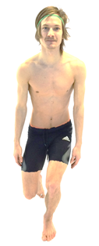
4. Assessing core stability
The standing, one-legged and three-plane core stability test
Notes:
Several studies have proposed different tests in order to monitor certain aspects of core stability (i.e. strength, endurance or neuromuscular control in the core). In their review, Kibler et al. (2006) suggested a core stability test by qualitatively looking at one-leg balance, squat and rotations in the three different planes. The subjects assume a one-leg stance in front of a wall. Then they either perform a squat or rotate their body towards the wall, without hitting it. Deviations in movement quality (e.g. reduced ability to maintain their single-leg stance) indicates reduced control and/or core weakness. According to the authors, clinical experience has demonstrated that their test battery provides useful information for rehabilitation protocols (Kibler et al., 2006). However, scientific evidence and/or validity/reliability data have not been presented.

Slide 13
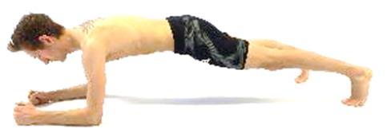
4. Assessing core stability
The plank
Notes:
Stanton et al. (2004) where the first to adopt the “plank” exercise for core stability monitoring purposes in a scientific study. The athletes assume a push-up position with the elbows on the floor and the body in a fixed position. The toes can be placed on the ground or in an unstable condition (e.g. ropes, Swiss ball, etc.). When the hip angle deviates 10° from the basic position assumed at the start of the test, the time to failure is recorded. To our knowledge, neither validity nor reliability data for the plank test have been presented in research literature.
The plank mainly assess core endurance, as it is dubious whether a four-stance exercise can examine stability. However, if segments are moved (e.g. an arm is lifted), then the stability aspect becomes more pronounced. According to Gottschall et al. (2013), integration of core exercises that require activation of the distal trunk muscles (deltoid and gluteal) elicit greater activation of primary trunk muscles in comparison with isolation core exercises that only require activation of the proximal trunk muscles.

Slide 14
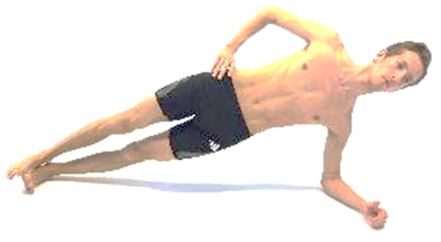
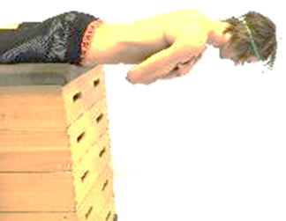
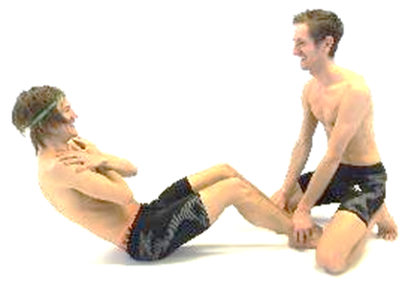
4. Assessing core stability
The McGill tests
Side bridge test
Extensor endurance test
Flexor endurance test
Notes:
The McGill tests evaluate isometric strength of the core (McGill et al., 1999). In the extensor endurance test, the athletes are horizontally positioned with the lower extremities fixed to an examination table while the upper body is extended over the edge of the table. In the side bridge test, the athlete is in a side-lying and nearly horizontal position, where only the feet and laterally fixed elbow support the body. In the flexor endurance test, the athlete is in a seated position with feet strap tightened, knees and hips flexed to 90° and the torso at a 60° angle relative to the table. In all tests, the athletes are asked to hold the fixed positions as long as possible (McGill et al., 1999). It should be noted that the objective of the McGill et al. study was to establish isometric endurance holding times, as well as ratios between torso extensors, flexors, and lateral flexors (stabilizers), for clinical assessment and rehabilitation targets. Thus, healthy subjects, not athletes, were used in this investigation.
Tse et al. (2005) assessed 45 college rowers in similar exercises prior to and after an 8-week core endurance exercise intervention. A broad range of functional performance measures were also assessed (vertical jump, broad jump, shuttle run, 40-m sprint, overhead medicine ball throw, 2,000-m maximal rowing ergometer test). The core group improved significantly in the two side flexion tests from pre- to post training test. Surprisingly, significant differences were observed in the extensor endurance test times for the control group, but not for the core group. No significant differences were found for any of the functional performance tests. Based on these results, the present tests do not seem valid for athletic performance.

Slide 15
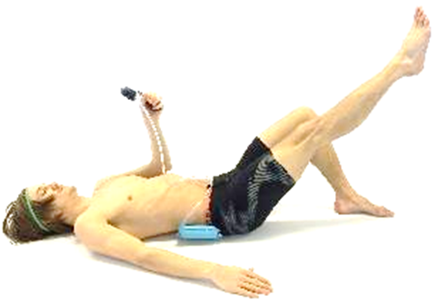
4. Assessing core stability
Sahrmann’s core stability test
Notes:
Sahrmann’s core stability test (Stanton et al., 2004): The subject lies supine and an inflatable pad of a Stabilizer Pressure Biofeedback Unit is placed in the natural lordotic curve. The pad is inflated to 40 mmHg. The subject then perform exercises (leg movements in varying directions and planes) with increasing level of difficulty. Deviations of >10 mmHG from the baseline value indicates that lumbar-pelvic stability is lost (Stanton et al., 2004). To our knowledge, neither validity nor reliability data for this test have been presented in research literature.

Slide 16
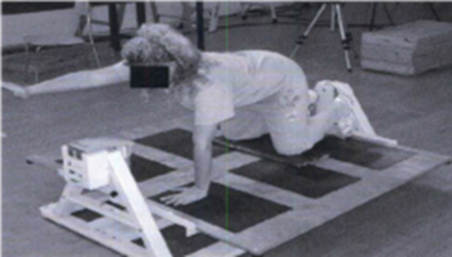
4. Assessing core stability
Balance test
Illustrations from: Liemohn WP, Baumgartner TA, Gagnon LH. Measuring core stability. J Strength Cond Res. 2005;19:583-586
Notes:
Liemohn et al. (2005) assessed core stability through balance tests where typical core stability postures were replicated. The athletes assumed three different postures (kneeling arm raise, quadruped arm raise and a bridging posture) on a stability platform. Each balance task had a duration of 30 seconds, and the balance board tilt limit was set at 5° to either side. Test performance was quantified by the number of seconds the athletes were able to maintain balance within the tilt limits. This balance test was originally designed for patients with low back pain, questioning the relevance to athletes. To our knowledge, neither validity nor reliability data for this test have been presented in research literature.

Slide 17
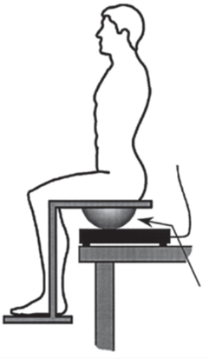
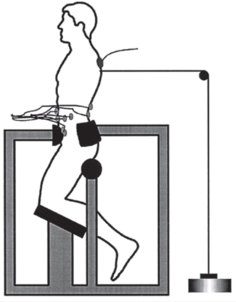
4. Assessing core stability
Unstable sitting test and trunk test
Trunk angle
Force plate CoP
EMG
Magnet release
Variable diameter
hemisphere
Figures from Radebold et al. Impaired postural control of the lumbar spine is associated with delayed muscle response times in patients with chronic idiopathic low back pain. Spine 2001; 26 (7): 724-30.
Notes:
Radebold et al. (2001) assessed core stability through an unstable sitting test. The subjects were placed on a seat with polyester hemispheres of varying diameter placed beneath, providing four levels of instability. A force plate under the hemispheres measured displacements of the center of pressure (CoP). The legs were fixed on a foot support to avoid movements of the lower extremities. The sitting tasks were performed with eyes open and closed. According to the authors, the test was designed to evaluate the brain stem postural control pathway, more specifically whether deficits in the postural control mechanism could be identified when the postural control of the lumbar spine was isolated from of the lower extremities.
Radebold et al. (2001) also designed another test to monitor the spinal reflex motor control pathway. Subjects were placed in an apparatus in a semi-seated position, and the lower extremities were prevented from motion. The athletes exerted isometric trunk flexion, extension and lateral bending, and the force level corresponded to 30% of maximal isometric trunk exertion. When the force was suddenly released by an electromagnet mechanism, the agonist-antagonistic response time of twelve trunk muscles (lower front and lower back) were monitored with EMG equipment. Agonists were defined as the active muscles prior to the force release, while antagonists were defined as the inactive muscles prior to the force release. The agonists ceased their activity immediately after the force release, while the opposite was expected to occur for the antagonists. In a later study, using the same test, Zazulak et al. (2007A) placed a sensor at the subjects back to assess trunk motion after the release.
Both the unstable sitting test and trunk test were originally designed for patients with low back pain. Thus, the tests have questionable relevance for athletes. To our knowledge, neither validity nor reliability data for this test have been presented in research literature.

Slide 18
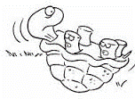

4. Assessing core stability
What is a good core stability test?
No core stability tests have been assessed for validity and reliability!
Notes:
According to Hopkins (2004), a good (sport-specific) test should be derived from logical reasoning, for example based on competition analyses. Moreover, physical tests should somehow be related to a criterion measure. A good test should also track training related changes within athletes (e.g. seasonal variations in physical capacity). Reliability is a quantitative expression of the reproducibility of the test when it is repeated (Hopkins, 2004). High reliability (measured as typical variation in scores from repeated tests under the same conditions) is required if we want to track small training-related changes. A test is considered reliable if this variation, called the typical error (TE), is smaller than the smallest worthwhile change (SWC) (Hopkins, 2004).
To the authors’ knowledge, no core stability tests have been properly assessed for validity and reliability according to the standards outlined by Hopkins (2004). This is surprising, given the large number of studies within the topic. Most tests have been criticized as they do not reflect muscle function during athletic activity (Bliven et al., 2013).

Slide 19
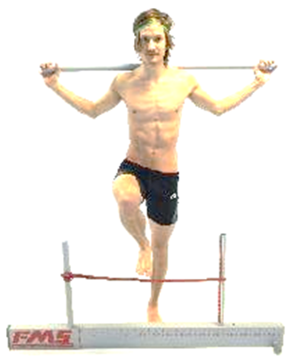

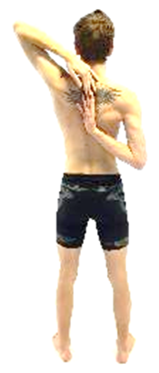
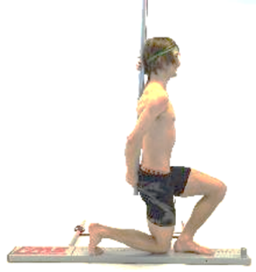
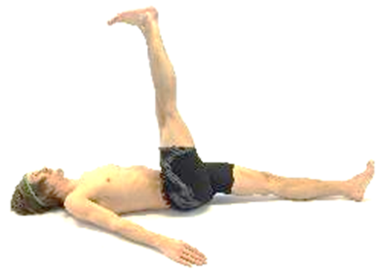
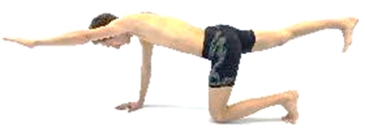

5. Functional movement screening (FMS)
Test protocol
Notes:
Previously described core stability tests do not translate well into athlete activities (Behm et al., 2010). In the contrary, specific performance tests only aim to assess quantitative information, without consideration for perfection or efficiency of underlying functional movement. With these limitations in mind, the functional movement screening (FMS) was developed by Cook et al. (2006). FMS is an evaluation tool aiming to assess the fundamental movement patterns of an individual, more specifically an injury risk screening tool. The test is comprised of seven fundamental movement patterns (deep squat, hurdle step, in-line lunge, shoulder mobility, active straight leg raise, trunk stability push-up and rotary stability) that require balance, mobility and stability. Most of the tests assess both right and left side. The scoring system ranges from zero to three, with three being the best score (meaning that maximal total score is 21 points).
0 points: When pain occurs while performing the exercise.
1 point: The subject is not able to complete the movements or assume the required positions.
2 points: The subject is able to complete the movement, but must somehow compensate.
3 points: The subject is able to perform the movements without compensations.

Slide 20


5. Functional movement screening (FMS)
Interpretation of results
Increased injury risk when total score is <14?
Questionable test-retest reliability
Poor inter-rater reliability
Notes:
The validity of the FMS regarding assessment for injury prediction has been questioned, as it does not take into consideration other factors contributing to injury risk (e.g. cognition, proprioception, mental and psychological awareness, emotional status, etc.) (Whiteside et al 2014).
Chorba et al. (2010) reported inter-rater reliability (ICC-values) from 0.77 to 1.0 for the seven tests. Scultz et al. (2013) reported test-retest reliability (ICC) of 0.6 and inter-rater reliability (Krippendorff α ) of 0.38 for the FMS test (total score). Teyhen et al. (2012) reported intra-rater test-retest and inter-rater reliability (ICC of the FMS composite score) of 0.76 and 0.74, respectively. The standard error of the measurement of the composite test (21-point scale) was within 1 point, while the minimal detectable change values were 2.1 and 2.5 points for inter-rater and intra-rater reliability, respectively. Unfortunately, CV-values have not been provided in any of the aforementioned reliability studies. In their review, Moran et al. (2015) reported moderate evidence that raters can obtain acceptable levels of inter-rater and intra-rater reliability of composite FMS scores when using live ratings. Similar review conclusion was reported by McCall et al. (2015). To date, there has been few high-quality studies within the topic, and the quality of several studies has been impacted by poor study reporting particularly in relation to rater blinding (Moran et al. 2015). In conclusion, test-retest reliability of the FMS test is questionable. Moreover, FMS scores are not comparable between raters. Differences among raters may influence the score’s clinical utility, and the FMS should be used cautiously to detect deficiencies that place the athlete at greater risk for injury (Schultz et al., 2013).

Slide 21
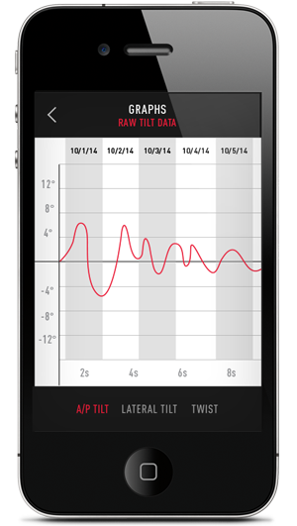
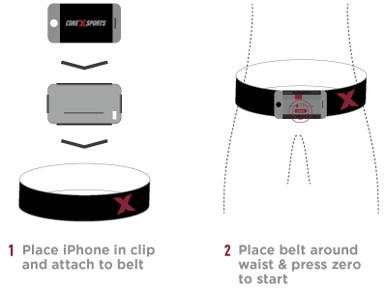
6. Future core stability monitoring?
Real time core position and immediate feedback
http://www.corexsports.com
Notes:
Manufacturers have recently developed smartphone-based applications measuring angle of pelvic tilt during (core)training exercises. The phone is placed in a clip attached to a belt worn around the waist, enabling athletes to perform sport-specific core training exercises. When core stability is no longer maintained and the body goes out of alignment, the app provides audible or vibration feedback to alert correcting movements. A larger range of error can be provided for novice athletes, but as they learn to engage core and control the pelvic angle, the precision can be increased (smaller range of movement error) to maximize training results.

Slide 22
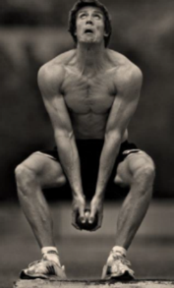
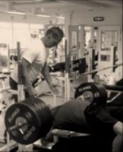
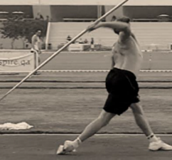
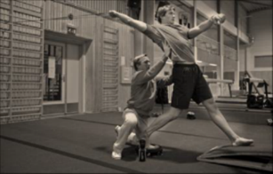
7. Training recommendations
General vs. specific training
General exercises
Special exercises
Specific exercises
Specificity is related to movement pattern, movement velocity, type of contraction and force of contraction
Notes:
A traditional belief within strength training is that the exercises should be as specific as possible in terms of movement pattern, movement velocity, type of contraction and force of contraction. Training should aim to replicate the intended activity, and departure from one of the mentioned factors may result in inappropriate adaptations (Sale & McDougall, 1981). According to Baker (1996), training exercises can be categorized as general, special or specific. General exercises stimulate the relevant muscles, special exercises are biomechanically more closer to the specific exercises than the general exercises (e.g. in terms of converting strength to power), while specific exercises are similar or very close to the performance/competitive condition (e.g. resisted or assisted loading). Aims of training decide whether general or specific exercises should be used. Overall, general exercises should be preferred if the aim is to improve contractile capabilities of the muscles (e.g. hypertrophy) or prevent injuries (Baker, 1996). High-velocity sports may need supplemental low-velocity training to induce maximal adaptation within the muscles (Sale & McDougall, 1981).
Regarding core stability exercises, speed and direction of movements should be functional and sport-specific (Lehman, 2006; Leetun et al., 2004). Most core stability exercises do not translate well into athletic activities (Behm et al., 2010). Based on traditional categorization of training exercises, core stability training exercises are mainly labeled as “general.”

Slide 23
7. Training recommendations
The traditional progression model
General exercises
Special exercises
Specific exercises
Level III: Proprioceptive or functional training exercises
Level II: Training exercises for local and global muscles
Level I: Isolating and recruiting the deeper local core muscles
Notes:
Although terminology (e.g. labelling and categorization of exercises) varies, the principle of progression has traditionally been heavily emphasized in scientific papers dealing with core stability training (O’Sullivan, 2000; Kibler et al., 2006; Borghuis et al., 2008; Hibbs et al., 2008; Bliven et al., 2013). According to O’Sullivan (2000), Comerford (2001) and Akuthota & Nadler (2004), initial core strengthening programs should enable subjects to become aware of motor patterns and learn to recruit muscles in isolation. Then the programs can progress to more functional positions and movement patterns. According to Comerford (2001), core stability training should range from isolated activation of the deep abdominal muscles to lifting weights on uneven surfaces. Overall, the progression patterns move from proximal to distal movements, static to dynamic exercises, isolated to integrated training and low to high intensity (O’Sullivan, 2000; Kibler et al., 2006; Borghuis et al., 2008; Hibbs et al., 2008; Bliven et al., 2013).
According to Lederman (2009), core stability training exercises clash with three important principles: The principle of specificity, internal-external focus principles and economy of movement. He argues that core stability exercises are dissimilar and out of context to normal physiological movement, representing an ineffective approach to learning motor skills. Additional tensing of trunk muscles during training are likely to be more energetically taxing of the body (Lederman, 2009).

Slide 24
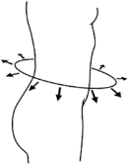
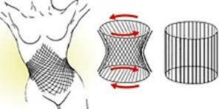
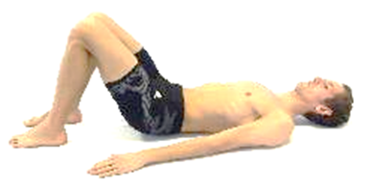
7. Training recommendations
Recruiting the deeper local core muscles
Abdominal hollowing or bracing exercises
Notes:
According to Comerford (2001) and Akuthota et al. (2004 and 2008), injured athletes or subjects with insufficient core stability should first (re)learn how to activate and isolate the deeper, local core muscles. This includes the transverse abdominis, multifidus, internal obliques, transversospinalis and pelvic floor muscles (Hodges et al., 1996).
Diaphragmatic breathing and abdominal hollowing/bracing exercises are typically used to activate and recruit the deeper local core muscles (Akuthota et al., 2004 and 2008). During hollowing exercises, local muscles are contracted such that the belly button is drawn towards the lumbar spine. Bracing exercises are performed by pushing the abdomen out externally (Barnett & Gilleard, 2005).

Slide 25
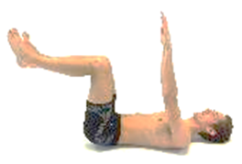
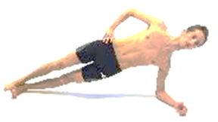
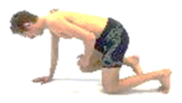
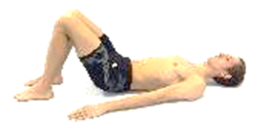
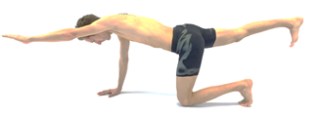
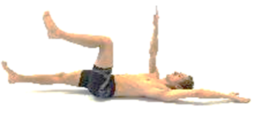
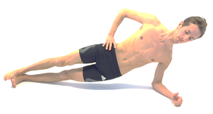
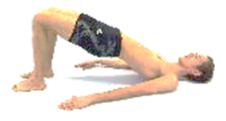
7. Training recommendations
Exercises for local and global muscles
Notes:
Once activation of the deeper core muscles are achieved, the exercises should progress by involving global muscles as well. Stimulation of local and global core muscles should include both strength, endurance and neuromuscular control (Faries & Greenwood 2007; Bliven & Anderson 2013). Commonly used exercises are e.g. curl-up, side bridge, bird dog, the plank, supine bridge, dead bug etc. (Carpes et al., 2008; Smith et al., 2008; Bien, 2011; Ekstrøm et al., 2007; Steffen et al., 2008; Liemohn & Baumgartner, 2005; Peate et al., 2007; Stevens et al., 2007; McGill & Karpowitz, 2009). Further progression can include combinations of exercises (e.g. side bridge to plank) or moving from single arm/leg raises to simultaneous contralateral arm/leg raises (McGill & Karpowitz, 2009).

Slide 26
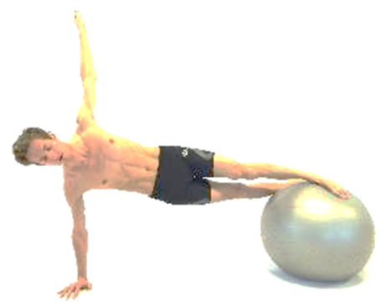
7. Training recommendations
Proprioceptive training
Notes:
Proprioception is the sense of the relative position of neighboring body parts and strength of effort being employed in movement. This is provided by muscle spindles, Golgi tendon organs and the fibrous capsules in joints. It is widely accepted that instability devices (e.g. Swiss ball, bosu ball, wobble board, roller boards, discs, ropes) challenges the core muscles and their neuromuscular control systems (Akuthota & Nadler, 2004; Behm et al., 2010; Hewett et al., 2002 ; Zazulak et al., 2007^{A}; Caraffa et al., 1996; Sæterbakken et al., 2011 and 2014), thereby improving the proprioceptive sense.

Slide 27
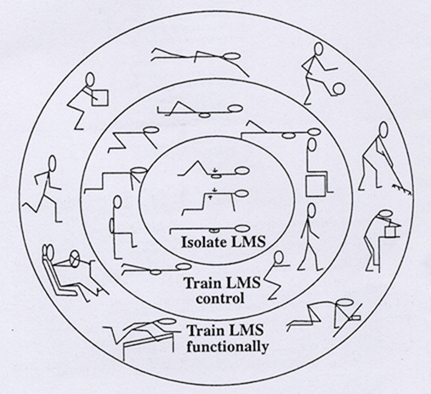
7. Training recommendations
The traditional progression model is not useful for athletes
Figure from O’Sullivan PB. Lumbar segmental `instability': clinical presentation and specific stabilizing exercise management. Man Ther. 2000;5:2-12.
Notes:
The traditional core training progression model was first presented by O`Sullivan (2000). However, this progression model was originally meant for patients with low back pain, not for competitive athletes. It is now generally accepted that core stability exercises are specific, with questionable translation from one exercise/skill to another (Tse et al., 2005; Saeterbakken et al., 2015). Thus, if the aim of the training is to perform well in e.g. the side-bridge exercise, the athlete should mainly perform this specific exercise. However, very few sport disciplines, if any, involve such a movement pattern. Several authors therefore argue to stimulate the core muscles in athletic function, not in isolation (Willardson et al., 2007; Reed et al., 2012; Saeterbakken et al., 2015).

Slide 28

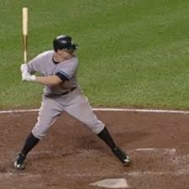
8. Core stability and athlete performance
Core stability has only been positively related to some sport-specific tasks with strong core components.
However, a true cause-effect relationship has not been established
Notes:
The core muscles (e.g. the diaphragm, abdominal and pelvic floor muscles) are activated during kinetic chain movements and are therefore central in terms of force transfer («the summation of speed» principle), providing proximal stability for distal mobility (Kibler, 1996; Marshall & Elliott, 2000; Hirashima et al., 2002; Kibler et al., 2006). Theoretically, “a break in the chain” may lead to impaired transfer of forces and subsequent drop in performance (Silfies et al., 2015).
Regarding the relationship between core stability and performance, many studies involving recreationally active persons have reported positive results (Reed et al., 2012; Silfies et al., 2015). Unfortunately, most studies do not focus solely on a competitive athletic population (Silfies et al., 2015). Sæterbakken et al. (2011) reported a positive effect of core stability training (unstable, closed kinetic chain movements) on throwing velocity in female handball players. Several studies involving athletes have reported a positive relationship between core stability and certain sport-specific tasks such as ball speed or accuracy during baseball pitching/batting (Stodden et al., 2005; Chaudhari et al., 2011; Reed et al., 2012), golf (Reed et al., 2012) or tennis serve (Fernandez-Fernandez et al., 2013), accuracy of ball throwing (Hirashima et al., 2003), shooting (Mononen et al., 2007), kicking and sprint performance (Prieske et al., 2016). However, a cause-effect relationship has not been established (Reed et al., 2012; Silfies et al., 2015), and it has not been revealed whether core stability training is MORE effective than other training forms (e.g. specific training, strength training, resistance training, plyometric training, etc.) in order to enhance performance.

Slide 29

8. Core stability and athlete performance
???
No direct link between core stability and athlete performance
It’s more a matter of SUFFICIENT core stability
Notes:
Functional movement screening score do not distinguish athletes of varying performance standard (Grygorowicz et al. 2013; Lockie et al. 2015^{A}). Moreover, there is no clear relationship between FMS sum score and performance measures like jumping, sprinting and agility (Okada et al. 2011; Parchman & McBride 2011; Teyhen et al. 2012; Chapman et al. 2014; Lockie et al. 2015^{B}; Lloyd et al. 2015). According to Borghuis et al. (2008), no clear evidence has been found for a positive relationship between core stability and physical performance.
In their systematic review, Reed et al. (2012) aimed to identify the association between core stability and sports-related performance measures. Twenty-four studies met their inclusion criteria. The authors concluded that core stability training provides marginal benefits to athletic performance. Because core training is mostly performed in combination with other training exercises and regimen, it is difficult to isolate the effects of core training alone.
Other authors emphasize the importance of sufficient core stability for optimal performance (Leetun et al., 2004; Myer et al., 2005).

Slide 30
8. Core stability and athlete performance
Isolated vs. integrated core training
Isolated core training should not be the primary emphasis for programs with the goal of enhancing performance. Instead, the training should be tailored to the athlete’s sport (specific training) to improve certain tasks.
(Reed et al. 2012)

Slide 31
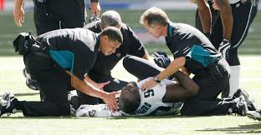
9. Do deficits in core stability increase the injury risk?
Yes No Unclear
Nadler et al., 2001 Nadler et al., 2002 Leetun et al., 2004 Cholewicki et al., 2005
Kiesel et al., 2007
Zazulak et al., 2007^{A} Zazulak et al., 2007^{B}
Hewett et al., 2009
Chorba et al., 2010
Hill & Leiszler, 2011
Chaudhari et al., 2014 Pontillo et al., 2014
Barton et al., 2015
Reeves et al., 2006
Silfies et al., 2007
Endo & Sakamuto, 2014
Harrington et al., 2014
Tate et al., 2012
Only studies involving competitive athletes are included here
Notes:
Nagar et al. (2014) observed greater thickness in transversus abdominis among subjects with nonspecific low back pain history compared to controls. The majority of investigations, including both case-control, cohort and prospective longitudinal studies, propose that deficits in core stability lead to athletic injuries. The studies include collegiate athletes,
subjects ranging from recreationally active to high-level, competitive athletes, and it is difficult to get a clear overview without knowing the athletes’ entire medical history.
In their systematic review, Barton et al. (2013) concluded that deficits in the gluteal muscles’ activation patterns could indicate impaired ability to control frontal and transverse plane hip motion, thereby increasing the risk for patellofemoral pain syndrome.

Slide 32


9. Do deficits in core stability increase the injury risk?
Do FMS scores <14 increase injury risk?
Yes No
Kiesel et al., 2007 Bardenett et al., 2015
Chorba et al., 2010 Hotta et al., 2015
O’Connor et al., 2011 Hammes et al., 2016
Butler et al., 2013 Bushman et al., 2016
Kiesel et al., 2014
Knapik et al., 2014
Warren et al., 2014
Garrison et al., 2015
Mokha et al., 2016
Studies typed in red involved soldiers or fire fighters.
The remaining studies involved competitive athletes.
Notes:
Several authors have identified FMS scores <14 as risk factors for injury (Kiesel et al., 2007; Chorba et al., 2010; O’Connor et al. 2011; Butler et al. 2013; Kiesel et al. 2014; Knapik et al. 2014; Warren et al. 2014; Garrison et al. 2015, Mokha et al., 2016). Others have not established a relationship between FMS score and injury risk (Bernadette et al. 2015; Hotta et al. 2015; Hammes et al. 2016; Bushman et al. 2016). According to Bushman et al. (2016), the use of the FMS to screen for the injury risk is not recommended because of the low predictive value and misclassification of the injury risk. Implementing the FMS as a screening tool may lead to prevention and treatment resources being directed toward individuals who are not at greater risk for injury (Bushman et al. 2015).

Slide 33


9. Do deficits in core stability increase the injury risk?
Study limitations
Unclear whether core stability deficiencies were present prior to injury or a consequence of injury deconditioning
Unclear to what extent poor core stability contributes to injury risk relative to other risk factors
Variations in study designs, exercises and subject characteristics complicate comparisons
Low sample sizes
Conclusion: Poor core stability in isolation is not a
predominant risk factor for athletic injuries
Notes:
In their critical review of the impact of core stability on athletic injury, Silfies et al. (2015) addressed several limitations in previously published literature on the topic. Firstly, the sample sizes were small in the prospective longitudinal studies that supported a positive relationship. Moreover, the study designs in most studies did not reveal whether core stability deficiencies were present prior to injury or a consequence of injury deconditioning. Finally, poor core stability as a potential risk factor has not been distinguished from other potential risk factors such as history of injuries, level of recovery, specific joint or muscle impairments, exposure to sport exercises, environmental conditions, etc. (Silfies et al., 2015).
According to Lederman (2009), imbalances between trunk muscles or weak trunk/abdominal muscles are not a pathology, just a normal variation. Lederman’s critical review concluded that weak or dysfunctional abdominal muscles will not lead to back pain. Zielinski et al. (2013) observed no relationship between lumbar multifidus muscle activation and clinical features in non-athletes.
In conclusion, based on previously published studies, there is not sufficient evidence to claim that poor core stability in isolation is a predominant risk factor for athletic injuries (Bliven et al., 2013; Silfies et al., 2015).

Slide 34
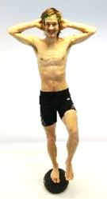
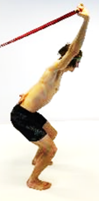
10. Does core stability training prevent injuries?
Yes No Unclear
Kiani et al., 2010
Wedderkopp et al., 1999
Hides et al., 2012
Hides & Stanton, 2014
Engebretsen et al., 2008 Holmich et al., 2010
Steffen et al., 2008
Van Beijsterveldt et al., 2012
Walden et al., 2012
Only studies involving competitive athletes are included here
Notes:
Regarding the effectiveness of core stability training as a part of injury prevention programs, previously published literature shows conflicting results. It is difficult to evaluate the effect of core training on injury prevention, as core training in most cases is a part of multifaceted programs, incorporating strength, endurance, balance/posture and neuromuscular control as well. In his critical review, Lederman (2009) concluded that tensing the trunk muscles is unlikely to provide any protection against back pain or reduce the recurrence of back pain.

Slide 35

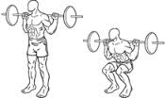
10. Does core stability training prevent injuries?
Proprioceptive vs. traditional strength training
?
Proprioceptive training prevent injuries
But traditional strength training is even more effective
Notes:
A systematic review and meta-analysis performed by Lauersen et al. (2014) investigated the effectiveness of exercise interventions to prevent sports injuries. Twenty-five trials, including 26610 participants with 3464 injuries, were analyzed. Studies with multiple exposures, proprioceptive training and strength training all showed a tendency towards increasing effect for both acute and overuse injuries. No beneficial effects were shown for stretching. Interestingly, strength training was more effective than proprioceptive training. Strength training reduced sports injuries to less than one third, while overuse injuries could be nearly halved (Lauersen et al., 2014).
The findings by Lauersen et al. (2014) are in line with Lederman’s critical review conclusion; that core stability exercises are no better that other forms of exercise or physical therapy. In fact, there may be a potential danger of damaging the spine with continuous tensing of the trunk muscles during daily and sports activities, and injured athletes should be discouraged from using e.g. hollowing and bracing exercises (Lederman, 2010).

Slide 36

11. Does core stability training enhance injury recovery time?
In the later half of the 1990s, this notion became widespread among physiotherapists for treatment of low back pain
More recent studies disprove the efficiency of such a practice
Notes:
In the later half of the 1990s, Hodges & Richardson (1996) reported deficits in trunk muscles during varying movements in patients with low back pain. They also observed pre-activation of the transversus abdominis muscle prior to limb movements, interpreted as a protection and stabilization of the spine during movements (Hodges & Richardson, 1997). These and similar findings, derived from studies of non-athletes, initiated a widespread belief among physiotherapists that stimulation/activation of the deeper trunk muscles would be effective for patients with lower back pain. However, recent studies have disproved the efficiency of such a practice.

Slide 37

11. Does core stability training enhance injury recovery time?
Core stability training improve low back pain symptoms, but no better than any other training forms in the long term.
Core stability training may be useful if other training/treatment forms are even more painful to perform.
Notes:
A systematic review performed by Wong et al. (2014) revealed that feedforward activation of transversus abdominis were unrelated to temporal changes in low back pain-related disability.
Smith et al. (2014) performed a systematic review (29 studies included, involving more than 2000 subjects) where the aim was to investigate the effectiveness of stabilization exercises for the treatment of non-specific low back pain, and compare any effectiveness to other forms of exercise. The results suggested that core stabilization exercises improved low back pain symptoms, but no better than any other form of active exercise in the long term. Thus, stabilization exercises cannot be recommended for low back pain in preference to other forms of general exercise, and further research is unlikely to considerably alter this conclusion (Smith et al., 2014). However, it is reasonable to claim that core stability training may be an adequate alternative if other training or treatment forms are even more painful to perform. Findings by Vibe Fersum et al. (2013) and O’Sullivan & Ivan (2014) support this notion.
FORMI (a communication- and research unit for musculoskeletal disorders in Oslo, Norway) has an overall vision to ensure a high level of quality in care for patients with musculoskeletal disorders. They recommend information, mobility-, strength- and cardiovascular training for patients with sub-acute and long-term low back pain (www.formi.no/english).

Slide 38

12. Conclusions
Varying “core” definitions used can make for a lot of confusion, involving varying anatomical structures
Validity and reliability data of core stability tests are either poor or absent
A causal relationship between core stability and athletic performance has not been established
Poor core stability in isolation is not a predominant risk factor for athletic injuries
Core stability training is not a superior treatment form for reducing injury recovery time
Isolated core training should not be the primary emphasis for training or injury treatment programs
Core training should be tailored to the athlete’s sport to improve certain tasks

Slide 39

13. Perspectives
Future studies within the core stability-perspective are needed for
operational definition purposes
developing valid and reliable core stability tests
exploring cause-effect relationships among core stability and athletic performance in varying sport disciplines
outlying specific training exercises in sports disciplines with strong core components

