Slide 1

Assessing physical and physiological characteristics in soccer players
Why, what and how should we measure?
Thomas Haugen (PhD),
Norwegian Olympic Federation
Stephen Seiler (Prof.),
Faculty of Health and Sport Sciences,
University of Agder
Notes:
This presentation is mainly based on Thomas Haugen’s doctoral thesis «The Role and Development of Sprinting Speed in Soccer» plus other soccer-related studies carried out by the same authors in the time period 2011-2014. Professor Stephen Seiler played the adversarial role of «main supervisor» throughout the entire process.
In this presentation, we evaluate a large number of commonly used physical tests for soccer players and outline minimum standards for elite players. Moreover, we identify pros and cons/limitations with today’s available physical performance assessment tools and present reasonable arguments regarding what information is needed to potentially prescribe individual training intervention and thereby enhance overall soccer ability. Hopefully, our recommendations can serve as bottom line information for soccer practitioners.

Slide 2

Content
Slide
The importance of physical skills in soccer 3
Assessing soccer players 5
Micro-technology 8
Aerobic demands in elite soccer 10
VO₂max 11
Yo-Yo tests 14
Anaerobic demands in elite soccer 21
Linear sprinting speed 23
Repeated sprint ability/performance 31
Change-of-direction 35
Sprint testing considerations 38
Vertical jump 43
Conclusions 47

Slide 3

The importance of physical skills in soccer
There is no direct link between physical performance and team success
However:
«Anaerobic actions» precede goals
Fatigue affects technical performance and decision making
Scoring frequency increases
with match duration
More injuries at the end of each half
SO……
Notes:
Performance in soccer depends upon a variety of individual skills and their interaction and integration among different players within the team. Technical and tactical skills are considered to be predominant factors. For example, pass completion, frequency of forward and total passes, balls received and average touches per possession are higher among successful teams compared to less successful teams.^{10,28,87} However, individual physical and physiological capabilities (both aerobic and anaerobic) must also reach a certain level for players to be successful.^{10,48-51,68,90,105} Faude et al.³⁹ analyzed videos of 360 goals in the first German national league and observed that anaerobic actions preceded the majority of goals scored, both for the scoring and assisting player. Rampinini et al.⁸⁷ observed a significant decline between the first and second half for several technical measures (involvements with the ball, short passes and successful short passes) in Italian Serie A players. Similar findings have been reported in a group of young soccer players, and the decline in technical performance had a significant relationship with physical fitness level.⁸⁶ Fatigue affects both scoring frequency³¹ and injury rate.^{36,59}

Slide 4
More opportunities with
well-developed physical skills
Perform more physical work on the field
Perform physical work with higher quality (i.e. win duels, create/avoid goal scoring chances)
Reduce relative match intensity and thereby avoid negative effects associated with fatigue (technical performance, decision making, injuries, etc.)
Notes:
Game analyses have revealed a reverse relationship between ball possession and distance covered.¹⁰ That is, inferior technical skills must be compensated for with more physical work. In contrast, teams with superior technical skills can perform the games at a lower relative work rate than their opponents.
Faude et al.³⁹ concluded that power and speed abilities are important within decisive situations in professional football and, thus, should be included in fitness testing and training.
Injuries affect team performance negatively in professional soccer.⁴⁴ According to Ekstrand,³⁷ coaches affect team injury rate more than doctors or physical therapists. Robust injury databases covering the best European leagues show that injury rates within teams to a large extent are affected by the team coach’s overall conditioning program.³⁷

Slide 5
Assessing soccer players
Why?
Evaluate individual and collective team behavior during training sessions and games
Develop benchmarks specific to playing standard and position
Provide a framework for individual and collective training prescription
Inform recovery strategies and load management
Notes:
Assessing soccer players is important to evaluate both individual and collective team behavior during training sessions and matches.^{7,15,22,25} According to Mendez-Villanueva & Buchheit,⁷⁸ soccer players should also perform less valid (non-specific) tests to get a clearer understanding of underlying causes and physical performance factors. Such information can in turn be used as framework for individual and collective training prescriptions, informing recovery strategies and load management. However, Bradley & Krustrup question the use and impact of non-specific tests. They argue that only soccer-specific tests that has undergone evaluation and critiquing by applied scientists should be used.⁷⁸

Slide 6
Assessing soccer players
What makes a good test good?
Valid
Reliable
Adds information value
Minimal negative consequences
Notes:
According to Hopkins,⁶¹ a good (sport-specific) test should be derived from logical reasoning, for example based on game analyses. Moreover, physical tests should somehow be related to a criterion measure. For example, a soccer-specific endurance test may be validated against e.g. high-intensity running in games. A good test should also track training related changes within athletes (e.g. seasonal variations in physical capacity).
Reliability is a quantitative expression of the reproducibility of the test when it is repeated.⁶¹ High reliability (measured as typical variation in scores from repeated tests under the same conditions) is required if we want to track small training-related changes. A test is considered reliable if this variation, called the typical error (TE), is smaller than the smallest worthwhile change (SWC).⁶¹
According to Buchheit & Mendez-Villanueva,⁷⁸ soccer-specific tests should add value (e.g. identify underlying factors that limit the test results) and not just confirm the coaches’ assumptions. Finally, we argue that a good test should lead to minimal negative consequences on overall soccer conditioning in terms of fatigue or injury.

Slide 7
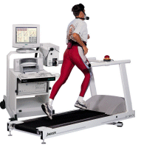
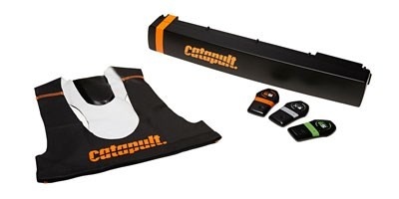
Assessing soccer players
Trend shift in monitoring technology
Traditional testing
Micro-technology
Blood lactate
VO_{2 max}
Monitoring
Training load
Linear sprinting
Intermittent running tests
Metabolic costs
Time motion
Agility/change of direction
Match performance
Vertical jump height
Repeated sprint ability
Recovery status
Computerized player tracking systems
Equipment
Gas analyzers
Heart rate monitors
Local positioning systems
Treadmills
Force platforms
Accelerometers
Electronic timing systems
GPS
Lactate analyzers
Purpose-built software
Notes:
Many physical tests have been validated and implemented in clubs and academies over the years to evaluate physical performance in soccer players. This long list includes linear sprinting, agility, repeated sprint ability, VO₂max, Yo-Yo intermittent tests, etc.5,6,12,49,50,51,64,67,68,99,100,102,105 However, a marked trend has arisen the last decade, as semi-automatic computerized player tracking technologies and global/local positioning systems with integrated accelerometers have been extensively applied in the best European soccer leagues for match analysis.^{22,25} This technology allows assessment of physical, technical and tactical performance parameters during training sessions and games. The advantage with such technology is obvious as a large range of performance data can be assessed quickly and accurately in “real-world” conditions. The introduction of modern match analysis technology has initiated a debate among professional practitioners and scientists regarding the value and usefulness of traditional off-field testing.⁷⁸ Are soccer-related fitness tests still necessary? Is it reasonable to assume that future soccer laboratories will consist of micro-technology and purpose-built software only, replacing timing gates, force platforms and metabolic gas analyzers?

Slide 8
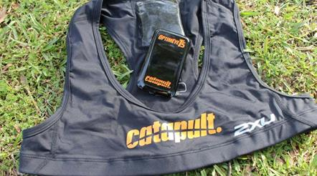
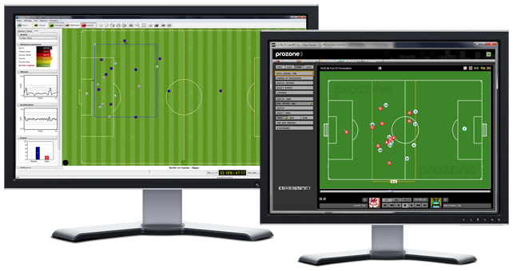
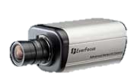
Micro-technology
Global positioning systems
Video tracking systems
Local positioning systems
Notes:
Video tracking of soccer players was introduced for the first time by Van Gool et al.¹⁰⁷ at the end of the 1980s. More than 50 scientific studies have been published the last five years, mainly using Amisco or Prozone.²² Global positioning systems (GPS) are satellite-based navigation systems originally built for military purposes. This technology was introduced to sport science at the end of the 1990s⁹⁴ and enables three-dimensional measurements of athletes over time. Lightweight devices are placed in players’ clothing. Local positioning systems (LPS) provide similar assessments, but data are captured by local base stations instead of satellites.^{15,65}
In most soccer leagues, players are not allowed to wear units/devices during matches. Thus, video tracking systems are typically used for match analysis purposes, while GPS/LPS are typically used to monitor training sessions.¹⁵

Slide 9
Micro-technology
Challenges and limitations
Disagreement across systems/technologies
Work rate patterns typically predefined by absolute speed zones
Validity and reliability decrease with increasing running velocity, shorter activity duration and more changes of directions
Experienced analysts required
Expensive
Notes:
Buchheit et al.¹⁵ observed disagreements across varying game analysis systems/technologies. For example, Prozone’s video tracking system overestimates high-intensity running by trivial to moderate margins, and accelerations are small-to-very largely greater with LPS. Fortunately, available calibration equations can integrate the systems with a moderate typical error of the estimate.¹⁵
Time motion analyses are typically predefined by absolute speed zones that vary across studies. For example, running velocity cut-offs ranging from 18 to 30 km·h⁻¹ have been used to distinguish sprinting from high speed running.⁵⁰ However, several authors argue that relative thresholds also should be provided.^{73,77}
GPS and LPS are more sensitive to acceleration and changes-of-directions than video tracking, but reliable results require multiple measurements. The higher velocities, the shorter activity durations and more changes-of-directions, the poorer reliability and validity.²⁵ Compared to video tracking systems, GPS and LPS incorporate metabolic cost measurements (individual power generation, work rate patterns and physiological stress), assessment of body contacts and collisions between players.²⁵
All currently available game analysis tools are expensive and require experienced analysts.

Slide 10
Aerobic demands in elite soccer
Observations from game analyses:
No relationship between game success and running performance
High-intensity running distance during matches has increased by 30% in the English Premier League the last 7 seasons
A myriad of contextual variables
Notes:
Most professional outfield soccer players run 10-12 km per match.^{10,17,18,32,69,84,109} Fullbacks and wide midfielders cover more distance than central midfielders, central defenders and forwards.³² Only 1-2% of total distance covered is with the ball. About 65-75% of the covered distance is walking or easy jog, 20-30% fast jog or moderate running, while 8-12% is high intensity running or sprinting.^{84,109} Average heart rate in games is 80-90% of HRmax, and level of blood lactate is 3-9 mM measured just after end of match.⁶⁹
Numerous contextual variables have been identified for distance covered (both total distance and high-intensity running distance): first vs. second half, opponent, ball possession, match status, match location, tactics/formation, league, time of year, physical capacity of players, etc.7,10,11,18,19,32,63,65,69,77,84,85,87,109
Overall, soccer performance places demands on individual and team aerobic capacity, but how much?

Slide 11
VO₂ max in elite soccer
Percentile | 99 | 90 | 75 | 50 | 25 | 10
Men | 74 | 69 | 66 | 63 | 60 | 57
Women | 66 | 62 | 59 | 55 | 52 | 49
Notes:
This slide presents percentiles for VO₂ max (ml∙min⁻¹∙kg⁻¹) among male (n=598) and female (n=152) elite players.^{51,105} The tests were performed at the Norwegian Olympic Training Center in Oslo during the time period 1989-2012. All included athletes played in the two highest divisions in Norway, and/or were members of the national team, but played for international clubs. A review by Stølen et al.¹⁰² confirms that VO₂max in male elite soccer players is in the (wide) range 50-80 ml∙min⁻¹∙kg⁻¹.
VO₂ max was the most commonly used laboratory test to assess aerobic capacity in soccer players in the 80s and 90s.^{35,102}

Slide 12
VO₂ max according to playing standard
Values are mean ± SD
Notes:
The importance of high maximal aerobic power in modern soccer has been heavily debated, and numerous studies of players’ VO₂ max have been published over the years.¹⁰² These figures show that VO₂ max does not differ between players who differ in playing standard at the higher levels.^{51,105}
Ekblom³⁵ concluded already in 1986 that 60-65 ml∙min⁻¹∙kg⁻¹ was sufficient to play at international level in male soccer. One decade later, Reilly et al.⁹¹ claimed that VO₂ max is not a sensitive measure of performance capability in soccer and suggested that VO₂ max > 60 ml represents a threshold to possess the physiological attributes for success in male elite soccer. Recent findings¹⁰⁵ support the claims by Ekblom and Reilly et al.
Group mean values 52-57 ml∙min⁻¹∙kg⁻¹ for women seem to be sufficient to play at a high level.^{51,102} Pitch size and number of players are identical in male and female soccer, but women have on average 15% lower aerobic capacity. Perhaps VO₂ max is a more important determinant in female soccer?

Slide 13
VO₂ max according to season time
Values are mean ± SD
Notes:
Professional soccer players have lower relative uptake during off-season compared to pre-season and in-season by a small, non-significant margin.¹⁰⁵ Overall, there are only small differences in VO₂ max within categories (playing standard, positions, seasonal variations). VO₂ max among male professional players has not changed over the last two decades.¹⁰⁵ However, there has been a slight, but non-significant trend towards lower VO₂ max values over an 18 year period of testing in female national team players.⁵¹
Even though the VO₂ max test detects underlying physiological changes, the test is impractical , time consuming, laboratory-based (off-field) and have questionable relevance to intermittent exercise.⁶ The test does not take into account one of the most important aspect of running performance, that is running economy. However, running velocity at VO₂ max can be a useful marker. Finally, the VO₂ max test requires expensive equipment and experienced test leaders.

Slide 14
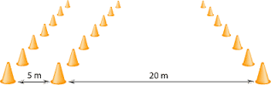
The Yo-Yo tests
Yo-Yo Intermittent Endurance Level1
Yo-Yo Intermittent Endurance Level 2
Yo-Yo Intermittent Recovery Level 1
Yo-Yo Intermittent Recovery Level 2
Notes:
The intermittent Yo-Yo tests were developed and introduced in the 90s by Jens Bangsbo and his associates at the University of Copenhagen, as they questioned the relevance of the laboratory based VO₂max test.⁶ The Yo-Yo tests consist of 20+20 m shuttle runs with incremental intensity and come in four different versions: Yo-Yo IR1, Yo-Yo IR2, Yo-Yo IE1 & Yo-Yo IE2. Recoveries between each run are 5 s for IE-tests and 10 s for IR tests. Level 1 tests begin at lower speed, with smaller incremental increases compared to level 2 tests. The IE versions are more aerobic than IR, and level 2 tests are more intensive than level 1. Test scores are reported as completed level or completed distance in meters. The Yo-Yo tests take several underlying performance variables into account: Aerobic capacity, running economy, change-of-direction and recovery abilities. Correlations between VO₂ max and Yo-Yo test performance is ~0.7.^{6,67,68} Correlations between Yo-Yo test performance and high-intensity running distance covered in games have been reported in the range 0.54-0.76.^{6,9,10,12,67,68} Due to their practicality and low expenses, the Yo-Yo tests have been widely applied to assess players’ abilities to repeatedly perform high-intensity exercise. IR1, IR2 and IE2 are most used in elite soccer.

Slide 15
Yo-Yo IE2 according to playing standard
Values are mean ± SD
Notes:
This slide shows reported Yo-Yo IE2 test results across studies involving soccer players.^{9,10,12,20,70,96,97} Bradley et al.¹⁰ observed no significant differences among the three upper leagues in England (trivial/small effect magnitudes).

Slide 16
Yo-Yo IR1 according to playing standard
Values are mean ± SD
Notes:
This slide presents Yo-Yo IR1 test results across soccer-related studies.^{20,23,38,45,64,79,89} Notice the results for a sample of Italian Serie A players and results from a Spanish sample from 2nd and 3rd division teams. Would it be beneficial for e.g. Italian Serie A players to improve their IR1 performance (team average) from 2200 to 3000 m and thereby reach the same level as the Spanish 2nd-3rd division players?

Slide 17
Yo-Yo IR2 according to playing standard
Values are mean ± SD
Notes:
This slide presents Yo-Yo IR2 test results among different European players samples.^{38,64,68,80,89} Interesting to note that the ENTIRE upper league on Faroe Island (n=172) achieve the best average results.

Slide 18
Yo-Yo according to season time
Values are mean ± SD
Notes:
This slide shows seasonal variations in Yo-Yo test performance.^{80,96} Interesting to note that the Portuguese players managed to improve their test score by 100% during the pre-season period. Is it reasonable to argue that the least intensive Yo-Yo tests are more sensitive to track training-related changes, compared to the most intensive Yo-Yo test versions?

Slide 19
Sufficient Yo-Yo test scores for elite players
(group mean values)
Men Women
Yo-Yo IE2 2200-2400 m 1500-1700 m
Yo-Yo IR1 2000-2200 m More data needed
Yo-Yo IR2 900-1000 m Not recommended (too intensive)
Notes:
Overall, Yo-Yo test performance (mean) does not differ between players who differ in playing standard at the higher levels, and it is more a matter of reaching a certain minimum. Previous slides show that the entire Faroe Island league (Yo-Yo IR2) , Spanish 2nd-3rd division players (Yo-Yo IR1) and Scandinavian soccer players have achieved the best Yo-Yo results. Bradley et al.¹⁰ observed no Yo-Yo IE2 performance differences across the three upper leagues in England. In conclusion, aerobic endurance/capacity is not a performance distinguishing variable in elite soccer.
Mendez-Villanueva & Buchheit⁷⁸ point out that the Yo-Yo tests in isolation provide limited information regarding which underlying performance variable(s) that potentially limit a poor test score. If the main aim is to improve a player’s ability to perform high-intensity intermittent exercise (in games), additional tests are required to determine whether the poor test performance is due to aerobic capacity, running economy, change-of-direction, recovery abilities, etc.

Slide 20
Challenges with Yo-Yo tests
Did subject false start?
Did subject cross the finish line before the beep?
Subjects risk to be ruled out because of pacing strategies
Test score affected by subject motivation
Are the tests «overly» sensitive?
Notes:
Several methodological challenges arise when performing the Yo-Yo tests, and the challenges increase with larger test groups. Firstly, what is considered a legal start? Is everything OK as long as the athletes’ feet are behind the line at the time of beep? Or should we allow no movement/momentum what so ever prior to the beep? Clearer regulations are needed here. Most dedicated software have a built-in countdown procedure (e.g. “3-2-1-beep”), allowing the athletes to “predict” the time of beep. Would it be easier to “judge” the starts if no countdown procedures were provided? This would probably lead to poorer test results, but perhaps strengthen reliability.
Secondly, how do we judge whether the athletes reached the finish line before the beep? Must one foot be in contact with the ground at or after the finish line? Is it enough that one body part has reached the finish line, regardless of the vertical level? Or should we only consider the torso (chest), as performed in athletics running events? Overall, clearer testing guidelines would improve Yo-Yo test validity and reliability.
Another concern with the Yo-Yo tests is that subjects risk to achieve poorer than optimal results due to faulty pacing strategies. In order to maximize the test results, it is crucial to run as slow as possible but still reach the finish line at the time of beep. Additional measures (e.g. heart rate, blood lactate) are perhaps needed to verify whether exhaustion occurred.
Finally, are the tests “overly” sensitive? Seasonal variations up to 100% are reported. Are small changes in physical condition magnified? Are we identifying differences that have little performance relevance? Interpretation should likely be similar to time-to-exhaustion tests, where outcome changes are ~15x larger than underlying physiological changes.

Slide 21

Anaerobic demands in elite soccer
Observations from game analyses:
Mean top speed in males 31-32 km.h⁻¹
~1 sprint/acceleration per minute per match
Sprints last typically 2-4 s
Sprints (with or without direction changes) and jumps (headings) precedes two thirds of all goals
Notes:
Observed top speed (team average) in males (31-32 km·h⁻¹)⁸⁵ corresponds to 1.12-1.16 s for a 10-m sprint interval.
Players typically perform ~1 sprint/acceleration per minute per match.⁶⁵ Mean sprint duration is 2-4 s, and 90% of all sprints are shorter than 20 m.^{17,85,109} About 70% of all sprints start from a run, potentially magnifying the importance of peak velocity.³² A linear sprint precedes 45% of all goals, usually without defender or ball.³⁹

Slide 22

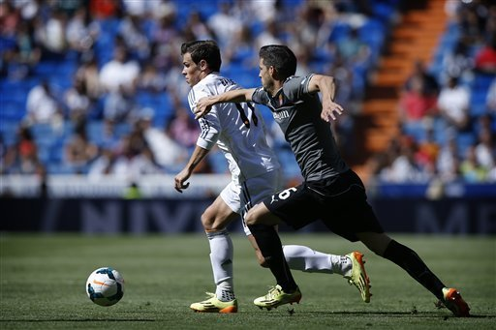
«Mind the gap»
Creating or closing a 50 cm gap can be decisive.
Notes:
According to Hopkins et al.,⁶⁰ the smallest worthwhile performance enhancement/change in team sport is 0.2 of the between-subject standard deviation. Based on robust database material,^{48,49} this corresponds to ~0.02 s over a 20-m sprint. In practical settings, a 30-50 cm difference (~0.04-0.06 s over 20-m sprint) is probably enough in order to be decisive in one-on-one duels by having body/shoulder in front of the opposing player.⁵⁰ Thus, the ability to either create such gaps (as performed by Garreth Bale in the right picture) or close those gaps (as performed by Roberto Carlos in the left picture) can be the difference between winning and loosing the game. But, how fast is fast enough?

Slide 23
Linear sprinting speed in elite soccer
Males (n=628) |  |  |  |  |  | Females (n=165)
PCTL | 10m (s) | 20m (s) | 30m (s) | 40m (s) | PV (m.s⁻¹) | 10m (s) | 20m (s) | 30m (s) | 40m (s) | PV (m.s⁻¹)
99 | 1.40 | 2.58 | 3.65 | 4.69 | 9.71 | 1.55 | 2.86 | 4.10 | 5.30 | 8.55
95 | 1.42 | 2.61 | 3.70 | 4.77 | 9.43 | 1.57 | 2.90 | 4.13 | 5.34 | 8.33
90 | 1.44 | 2.64 | 3.75 | 4.84 | 9.30 | 1.59 | 2.93 | 4.15 | 5.41 | 8.20
75 | 1.48 | 2.70 | 3.82 | 4.92 | 9.10 | 1.64 | 3.00 | 4.29 | 5.54 | 7.94
50 | 1.52 | 2.76 | 3.91 | 5.04 | 8.81 | 1.69 | 3.08 | 4.37 | 5.69 | 7.65
25 | 1.56 | 2.83 | 4.00 | 5.17 | 8.55 | 1.72 | 3.16 | 4.53 | 5.86 | 7.40
10 | 1.60 | 2.89 | 4.08 | 5.26 | 8.36 | 1.79 | 3.23 | 4.64 | 6.02 | 7.19
Notes:
PV = peak velocity
The table shows percentiles (PCTL) for sprint performance in male and female elite players.⁵⁰ The tests were performed at the Norwegian Olympic Training Center in Oslo in the time period 1995-2010. Included athletes all played in the two highest divisions in Norway, and/or were members of the national team, but played for international clubs. A floor pod placed on the start line was used for time initiation.
The table shows that the 75th -25th percentile difference is 0.13 and 0.16 s over 20 m sprint for male and female players, respectively, equivalent to a ~5% performance difference. Based on average velocity over the distance, the fastest quartile is ~ 1 m ahead of the slowest quartile over 20 m. Similarly, the 90th -10th percentile difference over 20 m sprint is equivalent to more than 2 m. Furthermore, the 10% fastest players run 1 m further than the 10% slowest players for each second during peak sprinting.
Mendez-Villanueva et al.⁷⁶ reported a strong relationship between sprint test performance and peak velocities reached in games.

Slide 24
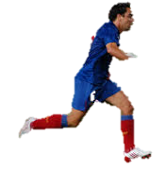


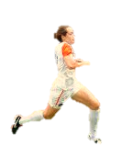
Fastest vs. slowest players over 20 m sprint
Men (n=628)
3 m
1st PCTL
50th PCTL
99th PCTL
3.5 m
Women (n=165)
1st PCTL
50th PCTL
99th PCTL
3.2
3.1
3.0
2.9
2.8
2.7
2.6
2.5
Time 20 m (s)
Notes:
This 20 m “photo finish picture” shows the difference between the fastest and slowest elite players, expressed in percentiles. The fastest males are more than 3 m ahead of the slowest players in a 20 m sprint. The differences are even bigger among females. The fastest female players are capable of beating ~25 % of all male players in a 20 m sprint.⁴⁸⁻⁵⁰

Slide 25
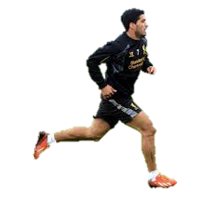
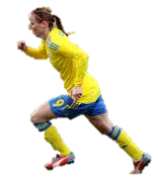

Acceleration speed (0-20 m) as a function of playing standard
Men
Women
Nat. team
(n=49)
Nat. team
(n=85)
1st div.
(n=315)
1st div.
(n=47)
2nd div.
(n=158)
2nd div.
(n=29)
3-5th div.
n=175)
3.4
3.3
3.2
3.1
3.0
2.9
2.8
2.7
2.6
Time 20 m (s)
Notes:
0-20 m sprinting speed trends predictably across playing level in both male and female soccer.^{48,49} 95% CIs are located at the timeline beneath the athletes. The magnitudes of the differences are in most cases large enough (~50 cm) to create or close a gap. There are larger time differences across female categories compared to the males.

Slide 26
Peak velocity as a function of playing standard
Notes:
Peak velocity trends predictably across playing standard in both male and female soccer, though with smaller differences among categories than acceleration speed.^{48,49}

Slide 27
Seasonal variations in sprinting skills
Pre-season
In-season
Off-season
3.4
3.3
3.2
3.1
3.0
2.9
2.8
2.7
2.6
Time 20 m (s)
Notes:
Thirty players in our database performed sprint tests at different times of season, allowing a repeated measures analysis. The results suggest that male players run faster off-season by a small, non-statistically significant margin compared to in-season and pre-season. Cross-sectional data from the same database confirm these results. There seems to be a reversed relationship between sprint performance and aerobic capacity/endurance according to time of season, as the latter capabilities have shown poorest tests scores off-season.¹⁰⁵ Sprint performance is negatively affected by constraints with overall team conditioning.^{52,56}

Slide 28
Sprinting speed as a function of time epoch
Women
Men
1995-1999
2000-2005
2006-2010
3.4
3.3
3.2
3.1
3.0
2.9
2.8
2.7
2.6
Time 20 m (s)
Notes:
Our robust database material provided us the opportunity to evaluate the evolution of sprint performance in soccer players over a 15 yr period. As we see, both male and female elite players have become faster over time,^{48,49} indicating that sprinting speed becomes more and more important in modern soccer. Interestingly, VO₂ max among the same groups of male professional players has not changed over time.¹⁰⁵ In fact, we actually observed a slight, but non-significant trend towards lower VO₂max values over an 18 year period of testing in female national team players.⁵¹

Slide 29
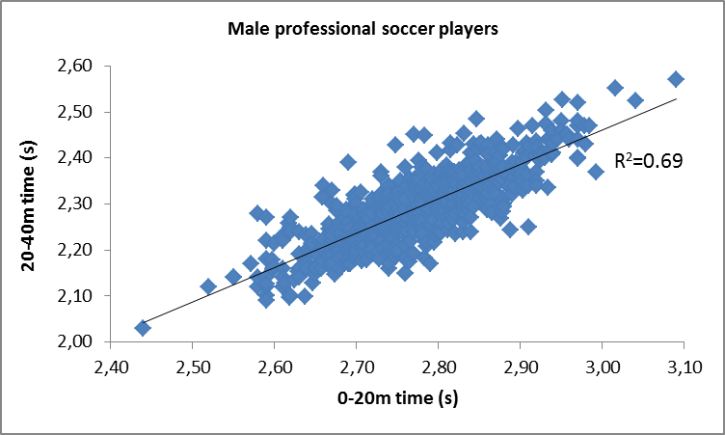
Acceleration-peak velocity relationship
Conclusion: Fast for 20 m, very likely fast for 40 m.
Notes:
Practically all soccer related studies have used testing distances in the range 5-40 m.⁵⁰ The present figure shows a very strong relationship between 0-20 m and 20-40 m sprint performance.
Data source: Electronic timing data (n=401) from the Norwegian Olympic Training Center, 1995-2010.⁴⁹

Slide 30
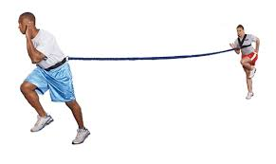
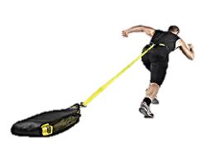
Assisted and resisted sprint tests
Valuable for individual training prescription
Notes:
Typical sprint testing provides limited information regarding which underlying performance variable(s) that potentially limit a poor test score. An increase in sprinting velocity can only be achieved by upsetting the balance between accelerating and retarding impulses. This can only be achieved by streamlining the sprinting movement pattern (technique) and/or expanding physiological resources (improved power).⁵⁵ In order to profile athletes, and thereby provide individual training prescriptions, we recommend to test athletes under assisted and resisted conditions as well, with assisted/resisted force corresponding to e.g. 5-7% of body mass. Relatively better performance obtained with resistance indicates that technical training should be prioritized. Similarly, relatively better assisted sprint performance indicates that muscular power training should be prioritized. It is, however, important to keep in mind that the time hindrance produced by resistance is larger than the time aid produced by assistance of the same intensity (e.g. head wind vs. tail wind) due to sliding filament mechanisms (muscle force production declines with increasing velocity of contraction).¹¹⁰ Thus, robust test result databases should be developed to assist practitioners.

Slide 31

Repeated sprint ability/performance
Repeated sprint ability
  Fatigue index
  Percentage decrement score
Repeated sprint performance
  Total time
  Mean time of all sprints
Notes:
Repeated sprint ability (RSA) is the ability to perform repeated sprints with brief recovery intervals (<60 s), so called repeated-sprint exercise.⁴² Two indices have mainly been used to evaluate RSA; the fatigue index or the percentage decrement score. Fatigue index is the relative drop-off in performance from the best to the worst sprint. The percentage decrement score compares actual performance to a “maximized” performance where the best trial is replicated in the formula.⁴³
Intermittent sprint exercise (RSE) is the ability to perform repeated sprints with sufficient recovery intervals (>60 s) to recover between the sprints.⁴² Such repeated sprint performance is measured as total time or mean time of all sprints.

Slide 32
Repeated-sprint test protocols in soccer studies
Study | Test protocol | TSD (m) | Recovery (s)
Krustrup et al., 2010⁶⁹ | 3x30m | 90 | 25
Gabbett, 2010⁴¹ | 6x20m | 120 | < 15
Aziz et al., 2007² | 6x20m | 120 | 20
Aziz et al., 2008³ | 8x20m | 160 | 20
Mujika et al., 2009⁸¹ | 6x30m | 180 | 30
Dellall et al., 2013²⁹ | 10x20m | 200 | 25
Dupont et al., 2010³³ | 7x30m | 210 | 20
Chaouachi et al., 2010²³ | 7x30m | 210 | 25
Meckel et al., 2009⁷⁵ | 6x40m | 240 | ~ 25
Meckel et al., 2009⁷⁵ | 12x20m | 240 | ~ 17
Impellizzeri et al., 2008⁶³ | 6x20+20m | 240 | 20
Bangsbo et al., 1994⁵ | 7x34.2m | 240 | 20-25
Wong et al., 2010¹¹² | 9x30m | 270 | 25
Tønnessen et al., 2011¹⁰⁴ | 10x40m | 400 | 60
Dupont et al., 2010³³ | 15x40m | 600 | 25
Little & Williams, 2007⁷² | 15x40m | 600 | ~ 8-12
Little & Williams, 2007⁷² | 40x15m | 600 | ~ 20-30
Arranged based on total sprint distance (TSD)
Notes:
The interpretation and usefulness of repeated sprint tests have been questioned over the years.^{82,98} Based on the short recovery periods between each sprint, most RSA test protocols simulate the most intensive game periods, leading to a possible overrating of the aerobic demands.⁵⁰ A review of previously published research involving repeated sprint testing of soccer players shows that protocols vary tremendously. According to Balsom et al.,⁴ it is easier to induce sprinting fatigue during a RSA protocol when sprint distance is 40 m, compared to 15 m. But, is this relevant for soccer? Moreover, Haugen et al.^{52,56} observed no performance decline when junior soccer players repeated twelve or fifteen 20-m sprints with 60 s of recovery. However, a significant decline in performance has been observed already after 3-4 repetitions during 40-m sprints, even with 6 min. recovery periods.⁴⁷ Thus, protocol variable manipulation (sprint distance, rest duration and repetitions) can dramatically influence interpretation of results and effect of training.

Slide 33
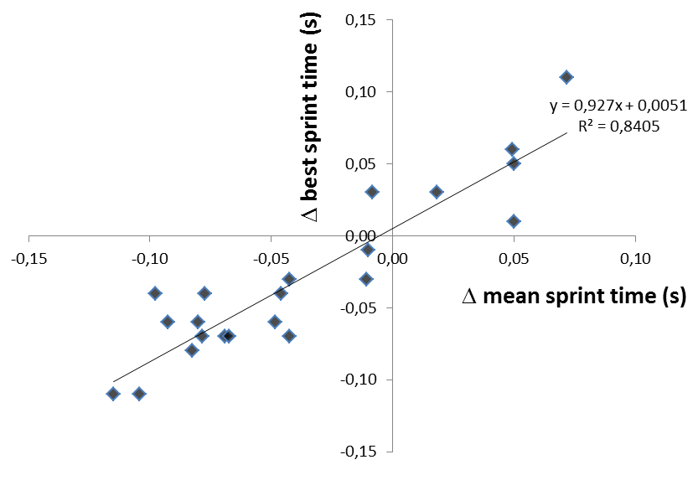
Is repeated-sprint testing necessary?
Notes:
This figure shows a very high correlation between change in best sprint time and change in average sprint time in a 12x20 m repeated sprint test (start every 60 s) after a 9-week sprint training intervention.⁵² Buchheit & Mendez-Villanueva¹⁶ reported that changes in repeated-sprint performance could be predicted/monitored by changes in maximal sprint speed and maximal aerobic speed.

Slide 34
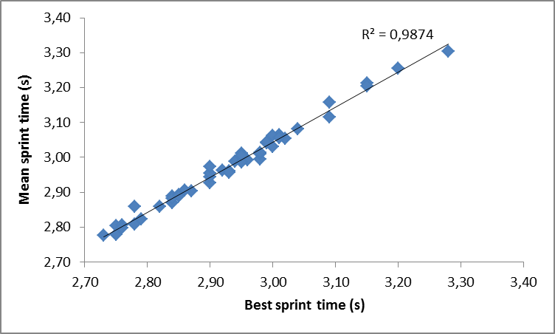
Is repeated-sprint testing necessary?
n=45
Notes:
This figure shows a near-perfect correlation between best and average sprint time in a 15x20 m repeated sprint test (start every 60 s).⁵⁶ High correlation between “best sprint time” and “mean sprint time” in repeated sprint tests (r=0.8) has also been observed when recovery between 20-m sprints is as short as 25 s.²⁹ Pyne et al.⁸³ reported that total time in a RSA test was highly correlated with single sprint performance and concluded that RSA was more related to sprinting speed than aerobic capacity. Recent findings by Buchheit¹⁴ confirm this relationship.

Slide 35

Change-of-direction
Most typical «explosive action» in soccer games:
Direction change
5-20m linear sprint
Fast jog
back to
position
Notes:
A player performs hundreds of direction changes in a match.⁸ However, most of them are initiated at low intensity/velocity. Change of direction usually happens in first step, followed by a linear run/sprint. Only 10-12% of all explosive actions are sprint-brake-sprint actions. The most typical “explosive action” is a direction change (up to 100-120 angular degrees), immediately followed by a 5-20 m linear sprint. When the situation has ceased, the player jogs back to position.⁸

Slide 36
Commonly used COD tests
Finish
Start
Finish
Slalom test
Finish
Start
Finish
T-test
Start
9-3-6-3-9 m
Start
Sprint with 90°
turns
Finish
Finish
Start
Finish
Start
Finish
Start
4x5 m sprint
Start
Pro-agility
L-run
505
Start
Illinois
Finish
Notes:
In research literature, tests are typically designed as zig–zag running, 90-180° turns, shuttle runs, lateral and backwards running.^{99,101} Typical COD tests do not mimic movement patterns in games.⁵⁰ In soccer, most CODs are reactions to stimuli, while all CODs in tests are planned. Midfielders perform relatively better on agility tests compared to linear sprinting.^{99,100} Kinetic energy = ½ mv², so COD tests will favor small players over bigger, faster players.
There are small correlations among strength/power measures and agility test results.⁷⁴ Moreover, there are small to moderate correlations among linear sprints and agility testing results.^{71,108}

Slide 37



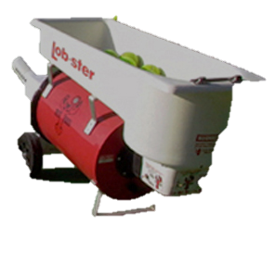
Future sprint test recommendations for soccer
•
Notes:
Is it possible to develop a sprint test that takes into account all soccer-related aspects (unplanned COD, linear and repeated sprint, even the dueling aspect)?
Setup details (suggestions): Inner circle 2 m diameter, outer circle 12 m diameter. Timing technology (marked as red lines) cover four sprinting directions (green arrows); forward, backward, to the left and to the right. A ball machine (as in e.g. tennis) sends the balls in four directions randomly (blue arrows). Time triggering occurs at the time of «ball release». Multiple trials (e.g. 3-5 trials to each direction x 4 directions = 12-20 repetitions in total) with e.g. 30-60 s recovery time in between. Performance can be stated as total time or mean sprint time, but also interesting with mean time for each direction to reveal individual strengths and weaknesses in COD. Time from «ball release» to first timing unit (inner circle) reflects cognitive processes, reaction time and COD-strategies. Time from first (inner circle) to second unit (outer circle) reflects 10-m linear sprinting ability.
Such a test is logical, based on movement patterns derived from game analyses. However, the main challenge is available, reliable and practical technology (time triggering at the moment of «ball release», in addition to triggering devices covering all directions). If proper technology is developed (wearable units preferred), would it be possible to test two players simultaneously to include the dueling aspect? We present an idea; can someone come up with technical solutions?

Slide 38
Sprint testing considerations
Timing equipment
Photocells
  Single beamed
  Dual beamed
  Split beamed
  Post prosessing
Floor pods
Audio start sensors
Visual start sensors
Video timing
Laser guns
Manual timing
Procedures
Starting positions
Start signals
False start regulations
Start distance behind timing device
Environmental factors
Air resistance
Air temperature
Barometric pressure
Humidity
Clothing
Running surface
Footwear
Notes:
Varying technology, procedures and unaccounted extraneous variables can affect sprint running and change-of-direction (COD) performance with immediate effect.⁵⁸ Thus, highly stringent methodological requirements are needed to detect “true” changes in performance.
General testing recommendations (for sprint/COD):
1) Dual beamed photo cells, laser guns and high-speed video timing are the most accurate tools. Manual timing and single-beamed photo cells should be avoided due to large absolute errors.^{46,47,53,58,113}
2) ≥20-30 m intervals are required to guarantee an accurate evaluation of sprint speed.¹³
3) Testing should be performed indoor to avoid influence of varying air resistance, temperature and precipitation.⁵⁸
4) Standardized procedures, footwear, surface and clothing.⁵⁸
5) Multiple trials to decrease measurement noise.¹⁰³

Slide 39
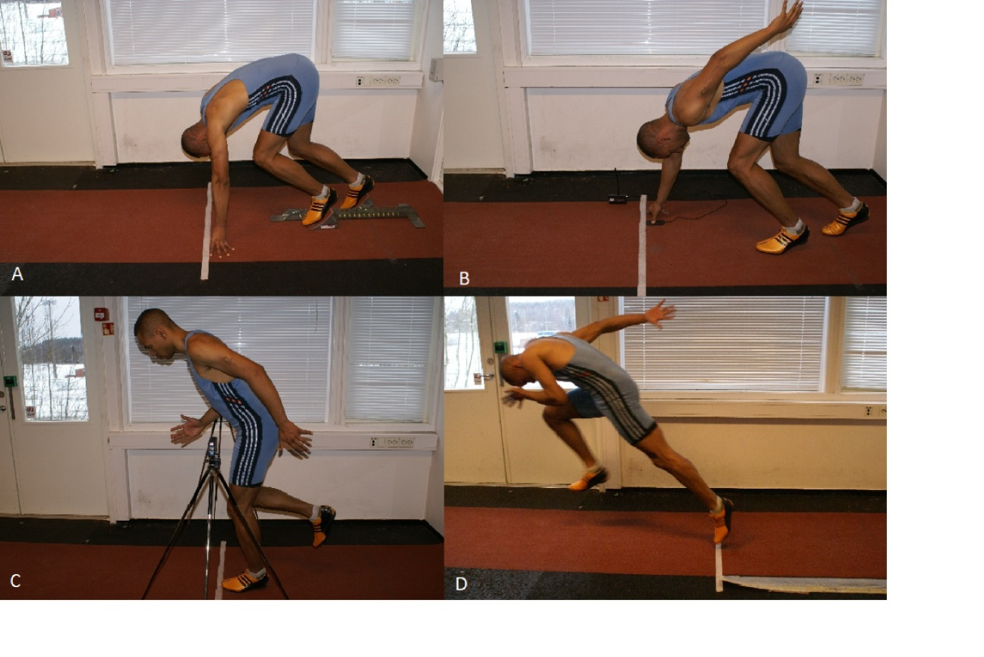
Starting positions
A) Block start with response to sound B) Three-point start with hand trigger
C) Standing photo cell start D) Standing on floor mat sensor
Notes:
Different start positions (either from fixed position or leaning backward before rolling forward) are commonly used in soccer. The impact of different starting positions and hardware devices on monitored sprint performance can be huge.^{34,47}

Slide 40
How do timing methods and start procedures impact the measured time?
Photo cell
Block start (ref.)
Floor pod
3-point
0.1
0.0
-0.1
-0.2
-0.3
-0.4
-0.5
-0.6
-0.7
-0.8
40 m time diff. (s)
Notes:
3-point starts with floor pod, photocell start and standing starts with floor pods yield 0.17, 0.27 and 0.69 s better 40 m sprint times, respectively, compared to block starts.⁴⁷ The differences are caused by inclusion/exclusion of reaction time, center of gravity placement and velocity at time triggering. Overall, the use in combination of different starting procedures and triggering devises can cause up to very large sprint time differences, which may be many times greater than the typically changes in performance associated with several years of conditioning.^{55,92,106}

Slide 41
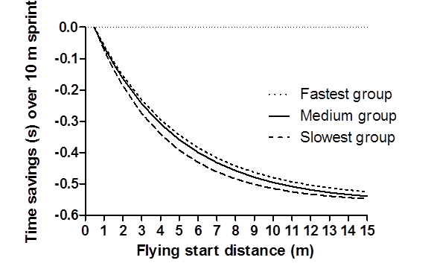
Time savings for 10 m sprint times across athlete groups and flying start distances
0.5 m flying start used as reference
n=44 junior soccer players (~15 in each group)
Notes:
Regarding flying starts, the time saving magnitudes are significantly influenced by starting distance behind the initial timing gate, sprint distance and athlete performance level.⁵⁷ Increasing the start distance behind initial timing gate (flying start distance) from 0.5 to 1.5 m leads to a performance enhancement of ~0.15 s,⁵⁷ which represents the difference between the 50th and 95th percentile in male soccer players.⁵⁰ Time saving differences over 10 m sprints among groups of varying sprint performance standards increase to approximately 5 m of flying start distance and decrease thereafter.⁵⁷ The between-group differences observed are likely caused by varying sprint velocity development profiles.

Slide 42
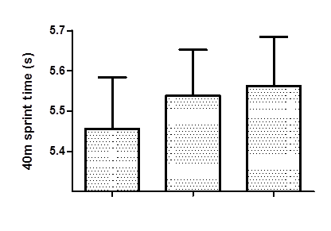
Effect of shoes and surface on 40 m sprint performance
Running spike shoes
on rubberized surface
Artificial turf shoes
on rubberized surface
Artificial turf shoes
on artificial turf
Notes:
Sprint times for soccer players are affected by the conditions under which they are run. Footwear affects sprint performance more than type of floor surface. Running spike shoes yield significantly ~0.05s better sprint times for both 0-20 m acceleration and 20-40 m maximal sprint compared to artificial turf soccer shoes, while floor surface affects sprint performance by a trivial and non significant margin (0.02-0.03 s over 40m).⁵⁴ Group mean values between fastest and slowest sprinting conditions (spike shoes on rubberized turf vs. artificial turf shoes on artificial turf) showed 0.11-0.14 s difference in 40 m sprint performance. These observed differences are larger than the typical variation from test to test and most short-term sprint training intervention effects.⁵⁰

Slide 43
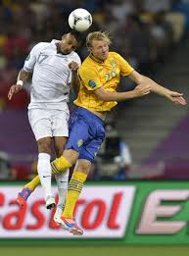
Vertical jump height demands in soccer
Are vertical jump capabilities important for soccer players?
Is there a relationship between leg extensor power and other soccer-related physical skills?
Notes:
The importance of vertical jump abilities in soccer players is heavily debated. Faude et al.³⁹ reported that jumps are one of the most frequent actions prior to goals, both for the scoring and assisting player. Based on these observations, they concluded that jumping (in addition to sprinting) should be included in fitness testing and training, as such actions are important within decisive situations in professional soccer. In contrast, Rampinini et al.⁸⁴ stated that the utility of assessing vertical jump performance is questionable as such skills have little relevance to soccer play.
Differences in testing procedures (i.e. with or without arm swing), equipment (i.e. contact mats vs. force platforms) and software complicate comparisons across studies. Future studies should take into account both individual stature and jump height to evaluate «maximal vertical reach»

Slide 44
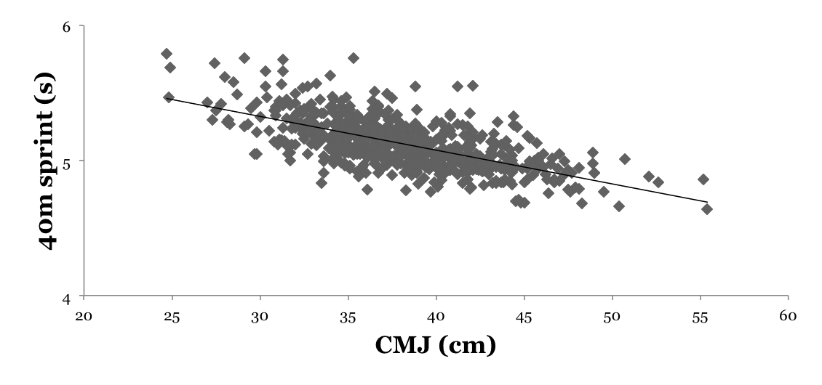
Relationship between sprint and jump performance
R² = 0.41, n= 634
Data collected at the Norwegian Olympic Training Center in the time period 1995-2010
Notes:
The correlation between sprint and CMJ performance in soccer players is 0.64. Stølen et al.¹⁰² claim that well-developed strength in lower limbs is important for soccer players, as this basic quality influences power performance and skills like sprinting, turning and change of direction. Wisløff et al.¹¹¹ reported a large correlation between maximal strength, sprint performance and vertical jump height, while Salaj & Markovic⁹³ concluded that jumping, sprinting and change of direction speed are specific independent variables that should be treated separately. Taken the arguments and observations together, it is likely that individuals with poor leg extension power relative to sprint performance should prioritize power development to a greater extent compared to their counterparts in order to enhance sprint performance.

Slide 45
CMJ according to playing standard
Notes:
CMJ performance (mean) does not differ between players who differ in playing standard at the higher levels. CMJ (without arm swing) values (group means) in the range 37-42 and 26-33 cm have been reported for male and female elite performers.^{1,21,48,49,100}

Slide 46
CMJ according to time epoch
Notes:
Our data showed that CMJ height increased by a small margin between the first two epochs for then to remain stable. The same professional players showed positive development in sprinting speed across the corresponding time epochs (slide 28).⁴⁹

Slide 47
Conclusions
The usefulness of physical tests for soccer
Test | TE (%) | SWC (%) | Usefulness with 1 trial
VO₂max ^{24,51,62,66,105} | 2.0-3.4 | 1.5 | Poor
Yo-Yo IE2 ^{9,10,12,90,96} | 3.9-4.5 | 2.4-5.0 | Alright
Yo-Yo IR1 ^{6,30,38,67} | 3.0-8.1 | 2.0-5.1 | Poor
Yo-Yo IR2 ^{6,38,68,80} | 7.1-12.7 | 3.6-4.5 | Poor
0-20 m linear sprint ^{49,51,57} | 1.2-1.4 | 0.6 | Poor
Maximal sprint speed ^{49,51,57} | 0.9-1.2 | 0.8 | Poor
T-test ^{90,99,101} | 1.7-3.3 | 0.6-0.7 | Poor
Sprint 4x5 m ⁹⁹ | 4.3 | 0.9 | Poor
Sprint with 90° turns ⁹⁹ | 2.9 | 0.6 | Poor
9-3-6-3-9 forward sprinting ⁹⁹ | 5.1 | 1.0 | Poor
Slalom test ⁹⁹ | 2.9 | 0.6 | Poor
9-3-6-3-9 backward/forward ⁹⁹ | 5.6 | 1.1 | Poor
6x(20+20 m) shuttle sprints ⁶³ | 0.8-1.3 | 0.3 | Poor
CMJ ^{24,49} | 4.8 | 2.4 | Poor
Notes:
When evaluating the usefulness of physical tests in soccer players, the following variables need to be considered:
The typical error of measurement (TE)
The smallest worthwhile change (SWC)
According to Hopkins, the usefulness of a test is poor if TE>SWC, and good if TE<SWC.⁶¹ The present table shows that the usefulness of most tests are considered poor when using this approach.

Slide 48
Conclusions: Does new technology move testing out of lab?
Evaluate individual and collective team behavior during training sessions and games:
Micro-technology required
Develop benchmarks specific to playing standard and playing positions:
Micro-technology AND traditional testing required
Framework for individual and collective training prescription:
Micro-technology AND traditional testing required
Inform recovery strategies and load management:
Micro-technology required
Notes:
Does new technology move testing out of lab? We argue that the answer to this question depends on the situation. High-standard soccer teams have tight game schedules, long seasons and relatively short pre-season periods, limiting the possibilities for long-term physical conditioning planning.¹⁹ As long as each player does his/her “job” satisfactorily on the field, all other physical and physiological considerations are secondary.²⁷ In such settings, the main focus is to recover and prepare for the next game. Underperforming players may be replaced by other players in the short term, while they risk to be sold to other clubs in longer terms. Game analyses and similar assessments of training sessions are the most important tools for evaluating individual and collective behavior.
In contrast, academies and reserve teams prepare for future career by developing soccer-specific motor skills and physiological capacity until they reach an elite level. The key skills must be maximized, while other capabilities merely need to meet a minimum requirement.^{10,91,105} In such settings, it is important to profile and diagnose players by the use of both specific and non-specific tests for then to develop targeted training prescriptions.

Slide 49

Summary of testing recommendations
Physical demand Remarks
Aerobic endurance A certain minimum is needed
Yo-Yo more practical and valid compared to VO_{2 max}
Linear acceleration Distinguishes players of varying standards
and peak velocity Equipment, procedures and conditions are critical
Change-of-direction Most sprints in games are linear
Most tests do not mimic on-field movements
Repeated sprinting Best sprint tells most of story
Short sprints induce little fatigue, long sprints are not game specific
Vertical jump A certain minimum is needed
Equipment and procedures are critical

