Slide 1
Estimating and Adjusting for Effects of Environmental Factors in Sport Research
Will G Hopkins¹, Patria A Hume¹, Steve C Hollings¹,
Mike J Hamlin², Matt Spencer³
–and– Rita M Malcata¹, T Brett Smith⁴, Ken L Quarrie⁵
¹AUT University, Auckland, NZ
²Lincoln University, Christchurch, NZ
³Norwegian Sport University (NIH), Oslo, Norway
⁴University of Waikato, Hamilton, NZ
⁵NZ Rugby Union, Wellington, NZ
Part 1: The Linear Mixed Model: a Very Short Introduction
  Linear = additive; adjusting for something; random and fixed effects.
Part 2: Environmental Effects on Performance
  Track and field; triathlon; rowing; cross-country skiing; rugby union.

Slide 2
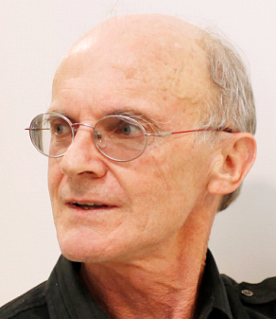
The Linear Mixed Model: a Very Short Introduction
Will Hopkins
Sportscience 14, 49-57, 2010
MSSE 41, 3-12, 2009
Linear = Additive
Almost all analyses are based on a model or equation consisting of predictor or independent variables (X₁, X ₂,…) added together to predict a dependent variable (Y): Y = a + bX₁ + cX₂ +… + error.
  These models are all just various forms of multiple linear regression.
Each X has values for something (e.g., temperature in °C), or is a "dummy" variable with values of 0 or 1 to represent absence or presence of something (e.g., venue: not indoors=0, indoors=1).
  Something with more than two levels (e.g., snow: spring, granular, compact…) is represented by more than one dummy X.
The effect of X₁ on Y is the value of the parameter or coefficient b.
  The unit of the effect is difference in Y per difference in X₁.
  So, for a dummy X, the unit is difference in Y when whatever X represents (e.g., indoors) is present.

Slide 3
You can have interactions to allow X₁ to have an effect that depends on X₂ (and vice versa): Y = a + bX₁ + cX₂ + dX₁X₂.
  If X₁=X₂, you get a quadratic effect of X: Y = a + bX + cX².
Adjusting for Something
This fantastic feature arises from the additive nature of linear models.
If Y = a + bX₁ + cX₂, the only possible interpretation of b is that it is the change in Y per change in X₁ when X₂ and any other predictors in the model are held constant.
We also say b is the pure effect of X₁ on Y, or the effect of X₁ controlled or adjusted for all other predictors in the model.
Ditto for all the other predictors in the model: each parameter is the pure effect of its predictor.
So, if the other predictors include the identities of the athletes…
  You can estimate the pure effect of each environmental condition, as if it were all for the same athletes.
  And parameters for the athletes allow you to estimate pure differences or changes for athletes, as if they were all in the same environment. Wow!

Slide 4
Yes, but athlete identities are different from other predictors…
Random and Fixed Effects
The athletes represent a sample from some population, so you get different identities if you repeat the study with a different sample.
  The variation of athlete identities from sample to sample is random.
  Hence athlete identity is a random effect.
But the identities of snow condition don't change from one sample to another. The identities are fixed, at whatever levels you choose.
  Hence snow condition is a fixed effect.
A mix of fixed and random effects is thus a mixed model.
  Some mixed models are also known as hierarchical or multilevel.
More fascinating facts about fixed and random effects…
  A numeric predictor like temperature is fixed, because everyone gets the same parameter.
  A predictor like race identity can be random, if it’s considered as a sample.
  You can include interactions between athlete identities and fixed effects to get unique effects for each athlete.

Slide 5
Here's another useful way to think about fixed and random effects…
  With fixed effects we estimate and account for means, differences between means, or the mean effect of differences in a numeric predictor.
  With random effects, we can still estimate the individual means (e.g., for each athlete), but we really account for variation, and we summarize it as a standard deviation.
The residual error (the differences between observed and predicted values) is a random effect.
  You can have different residual SD for different clusters of data between or within athletes. Example: more error when athletes are younger.
You can use a spreadsheet or ANOVA-type analyses to take into account random effects in some straightforward models.
But sophisticated models and large datasets need a stats package that supports mixed modeling: SAS, SPSS, R,…
  Dummy coding is automatic, but you should learn to include dummies yourself for special models.

Slide 6

Environmental Factors Affecting
Track and Field Performance
Steve Hollings
EJSS 12, 201-6, 2011
Data
From the fantastic Finnish site tilastopaja.org.
Lifetime career performances of male and female athletes in top 16 of any Olympics or World Champs 2000–2009.
  ~60 athletes and 1000-7000 performances in each of 19+19 events.
Analysis
Separate analysis for each event.
Dependent: log-transformed time (track) or distance (field) to estimate percent effects.
Fixed effects were included to estimate mean times or distances for…
  global competitions (Olympics or World Champs) vs the rest;
  altitude above vs below 1000 m;
  other factors not presented today: indoors vs outdoors, differences in wind speed, and mean differences in age modeled as a quadratic.
See the last slide for details of the model for this and the other projects.

Slide 7
Random effects are not presented here, but were included to account for variation in…
  quadratic age trajectories (trends) from athlete to athlete;
  each athlete's time or distance from one race to the next (the residuals).
    Different residual SD were estimated for global senior, global junior, and other competitions.
Effects were assessed using magnitude-based inference.
  Thresholds for small, moderate, large and very large effects defined by 0.3, 0.9, 1.6 and 2.5 of the within-athlete variability of top athletes between competitions (Hopkins et al., MSSE 41, 3-12, 2009) .
    The variability was 0.8% for track <3 km, 1.1% for track ≥3 km,
    2.1% for jumps, 3.3% for throws (Hopkins, Sportscience 9, 17-20, 2005).
  Magnitudes of observed values of effects with adequate precision (sufficiently narrow confidence intervals) were interpreted using these thresholds.
  Almost all effects had adequate precision even at the 99% level.

Slide 8

Effect of global competitions
small
enhancement
trivial
effect
small
impairment
Track (times)
Men (%)
Women (%)
100 to 400 m
-0.7
-0.8
800 m
0.0
-0.6
1500 m
0.6
-0.1
3000-m steeplechase
-0.1
-1.4
5000 m
1.2
-0.2
10000 m
0.2
-0.4
Field (distances)
Men (%)
Women (%)
Jumping
0.3 to 1.2
0.5 to 0.8
1.2
0.8
Throwing
-0.4 to 0.1
-0.3 to 1.7
1.7
Conclusion: compared with men, women are less strategic?
They just do their own thing?
Notes:
We categorized competition status into two components. Global competitions and others. Global events were the Olympic Games, World Athletics Championships, World Indoor Championships, and World Junior Championships.
Note that in the estimate of the effect, a negative value means that an performance is improved (i.e. a faster time). The uncertainty of the estimate is shown as +-
Global events produced substantially faster times in the three sprint events and the 110m Hurdles (interesting all by 0.7%), whilst the two middle distance events (1500m & 5000m) produced slower times at the global events. The 800m and 3000m steeplechase events showed little difference in times at global events when compared to other competitions.
The faster times in the sprint events at global competitions can be explained in that in winning these prestigious titles in a highly competitive field requires a maximum effort. Furthermore, athletes in these sprint events will taper specifically for these competitions aiming to reach the peak performance of the season at them.
Similarly, in the middle distance events, the aim of the athlete at these competitions is to win the event and so these races tend to be tactical rather than “going for a time” – it doesn’t matter what time you run so long as you win at these competitions. In other competitions (mainly Grand Prix competitions) there are usually financial incentives given for running a fast time and more often than not a one or more pacemakers are employed to ensure a fast race.
The 800m times in global competitions are comparable to the times in other competitions due to the fact that it is an “in-between event” – neither a sprint (all out effort) or a middle distance race (tactical)

Slide 9
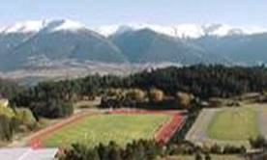
Effect of altitude (≥ 1000 m)
small
enhancement
trivial
effect
small
impairment
moderate
impairment
large
impairment
very large
impairment
Track (times)
Men (%)
Women (%)
100 m
-0.5
-0.4
200 m
-0.4
-0.5
400 m
-0.3
-0.1
110- & 100-m hurdles
-0.1
-0.1
400-m hurdles
-0.1
1.1
800 m
0.4
1.4
1500 m
1.9
2.8
3000 m steeplechase
1.7
3.0
5000 m
2.4
3.3
10000 m
1.0
3.6
Conclusion: altitude impairs women more than men. Why?
Notes:
Athletics statisticians and the international body have designated that performances achieved at a venue 1000m above sea level or higher be designated as an “altitude performance”. Records can still be set at altitude but are designated as “achieved at altitude”. There have been arguments that there should be two sets of records – those set at an altitude of 1000m and above and those set at an altitude below 1000m. The 1000m altitude figure is, as far as I can ascertain, purely an arbitrary figure.
We used the 1000m figure as the designation of whether the performance was done at altitude.
Three of the four sprint events produced substantially faster times at altitude (the 100m Hurdles produced only marginally faster times and is probably due to the fact that it is a “rhythm” event rather than a “flat out” event). The reason for the faster times at altitude of the three other events is due to the lower air resistance at altitude.
The 800m event produced slightly slower times at altitude. This is attributed to the fact that the 800m is a “break even” event at altitude – a combination of less air resistance (good) vs less oxygen (bad).
The 1500m, 5000m and to a lesser extent the 3000m steeplechase all produced slower times at altitude. This can be attributed to the reduction in the available oxygen at altitude and consequently the reduced aerobic power. In the 3000m Steeplechase, the lesser effect on slower times can probably be attributed to the fact that the large majority of the athletes in the sample were either born and/or raised and/or lived and/or trained at altitude.

Slide 10

Effect of Altitude on
Track and Field Performance
Mike Hamlin
in preparation
Data
Actual altitudes of race venues, merged with Steve's data.
Analysis
Same as before, but initially with altitude parsed into quantiles
(six levels: <150 m, 150-299 m,…).
Then with two dummy variables
to estimate a different continuous
effect of altitude below and above
some threshold (found iteratively).
  Time = Model1*Dummy1
  + Model2*Dummy2
Not finished yet–altitude appears
to be wrong somewhere!
Performance time
Model1
Model2
Dummy1=1
Dummy2=0
Dummy1=0
Dummy2=1
threshold
Altitude

Slide 11
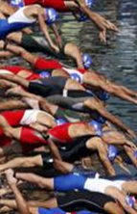
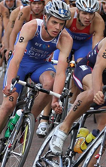
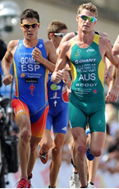

Tracking Career Performance of Successful Triathletes
Rita Malcata
submitted (almost)
Data
Performance times of 337 female and 427 male triathletes in 419 international races over 12 years (from triathlon.org).
Analysis
Fixed effects to account for different
types of triathlon and ability groups,
a linear calendar-year trend,
and a quadratic age trend.
Random effects for individual
quadratic age trends, and race
identity to adjust for environmentals.
Conclusion: including race ID permits
useful monitoring of career trajectories.
Results: figure withheld until the manuscript is accepted for publication

Slide 12


Variability and Predictability of
Finals Times of Elite Rowers
Brett Smith
MSSE 43, 2155-60, 2011
Data
Race times for the 10 men’s and 7 women’s single and crewed boat classes, each with ~200–300 different boats competing in 1–33 of the 46 regattas at 18 venues, 1999-2009 (from worldrowing.com).
Analysis
Separate analysis for each boat class.
Dependent: log-transformed times for percent effects.
Fixed effects to estimate mean times for…
  race finals (A, B, C,…)
  levels of competition (World Cup, World Champs, Olympics).
Random effects to account for variation in…
  times between boats overall and within each boat between years;

Slide 13
(Random effects to account for variation in…)
  times between the finals (A, B, C,…) within a competition, assumed due to transient differences in environmentals;
  times between venues, assumed due to consistent environmentals;
  each boat's time from one final to the next within each year (the residuals).
    Different residual SD were estimated for the A finals and the other finals.
    The residual SD for the A finals was used to get magnitude thresholds.
Results
CV for the residuals in A finals were 0.9% (crewed boats) through 1.1% (single sculls).
  So thresholds for small, moderate, large,... are ~0.3, 0.9, 1.6, 2.5, 4.0 %.
  Variability and thresholds for mean power are 3x more, because power = k.speed³. So rowing is less reliable than running, where power = k.speed.
Transient and consistent effects of environment were CV of ~3%.
  These have to be doubled before interpreting magnitude: extremely large.
Conclusion: to monitor on-water training performance times, you will have to measure and model environmentals.

Slide 14
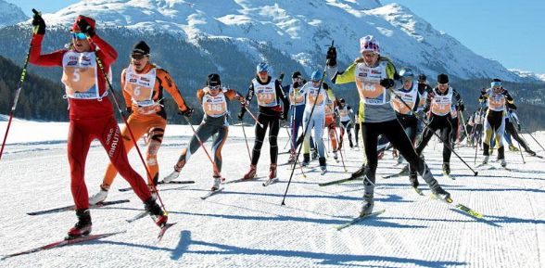

Variability and predictability of performance times of elite cross-country skiers
Matt Spencer
IJSPP (in press)
Data
Performance times in classical and free styles of women’s and men’s distance and sprint internationals, each with 410-569 athletes in 1-44 races at 15-25 venues 2002-2011 (from fis-ski.com).
Analysis
Similar to the analysis of rowing.
Separate analyses for each type of race for annual top-10 skiers.
Fixed effects to estimate mean times for…
  snow conditions (6 types);
  altitude (below or above 1200 m);
  different race distances (simple numeric) to adjust for different course lengths.

Slide 15
Random effects to account for variation in…
  times between skiers overall and within each skier between years;
  times between races, assumed due to differences in terrain and environmentals not associated with snow conditions;
  each skier's time from one race to the next within each year (the residuals).
Results
CV for the residuals of the top 10 were 1.1-1.4%.
  Similar to rowers. But here power = k.speed, so skiers are more reliable than rowers and almost as good as runners.
  Thresholds for small, moderate, large etc. are ~0.4%, 1.2%, 1.9%...
Effect of race distance in all events ~1 %/% (% time per % distance).
Huge variability in performance due to terrain: CV of 4-10%.
Effects of snow and altitude (~2%) were mostly unclear, probably because of the variability due to terrain.
Conclusion: adjustment for environmentals revealed highly reliable athletes in this sport.

Slide 16
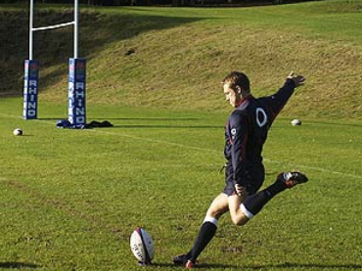
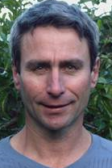
Goal-Kicking Performance in
International Rugby Union
Ken Quarrie
submitted
Data
6769 attempts by 101 kickers in 582 international matches 2002-2011
Analysis
Dependent: success of the kick, modeled as the log of the odds in a logistic regression with a generalized linear mixed model.
  Effects and SD are estimated as odds ratios and converted to percent rates evaluated at the mean success rate to interpret magnitudes.
  Key performance indicators represented by a count of actions can be modeled as the log of the count in a Poisson regression.
    Effects and SD are estimated as count ratios and expressed as percents.
Thresholds for small, moderate, large, and very large success ratios are 1.11, 1.43, 2.0, 3.3, 10 and their inverses 0.9, 0.7, 0.5, 0.3, 0.1.

Slide 17
Fixed effects to estimate mean success rate for…
  different kick distances (modeled as a simple linear effect);
  different kick angles (simple linear);
  differences in kick importance (a combination of points difference between the two teams and time remaining in the match; simple linear).
Random effects to account for variation in…
  each kicker's mean success rate;
  the effect of kick importance on each kicker's success rate;
  success rate between matches, assumed due to transient differences in environmentals;
  success rate between stadiums, assumed due to consistent differences in environmentals;
  Generalized linear modeling also includes an over- or under-dispersion factor that allows for non-randomness of events.
Results
[withheld until the manuscript is accepted for publication]

Slide 18
  Some changes in ranking between raw and adjusted rates were large. Example: Francois Steyn moved from 84/101 to 4/101.

Slide 19


Slide 20
  Some changes in ranking between raw and adjusted rates were large. Example: Francois Steyn moved from 84/101 to 4/101.
Conclusion: assessment of kick success is improved by adjusting for environmental and other factors.

Slide 21
Summary and Conclusions
Analyses of performance and performance indicators improve with adjustment for environmental factors.
Sophisticated mixed linear models are needed to deal with the repeated measurements.
Biomechanical variables should be amenable to such analyses, provided there is enough repeated measurements on the subjects.
Someone in your research group needs to be skilled with this kind of modeling.

Slide 22
Technical Details of the Models
In Steve Hollings' track-and-field study, the individual quadratic trajectories are specified by stating AthleteID, AthleteID*Age and AthleteID*Age² as random effects.
In Brett Smith's rowing study, these were the random effects:
  BoatID, to estimate each boat's mean ability.
  BoatID*Year, to estimate each boat's consistent form each year.
  RaceID*Final, to estimate and adjust for variation from final to final within competitions, assumed due to transient environmental factors.
  Venue, to estimate consistent differences between venues.
  Residual, to estimate within-boat final-to-final variability within years.
  Different boat and residual variances were estimated for the A finals and the other finals to allow separate estimation of variability of the top and other boats.
Here are Matt Spencer's random effects:
  SkierID, to estimate each skier's overall mean ability;
  SkierID*Season, to estimate each skier's consistent ability each season;
  RaceID, to estimate and adjust for differences in terrain;
  Residual, to estimate within-skier variability between races within seasons.
Finally Ken Quarrie's:
  KickerID, to estimate each kicker's mean success rate;
  KickerID*KickImportance, to estimate effect of kick importance on each kicker's success rate;
  MatchID, to estimate and adjust for mean differences in success rate between matches (due to environmentals on the day);
  StadiumID, to estimate differences in success rate between stadiums (due to consistent differences in environmentals);
  Residual, an over- or under-dispersion factor in logistic and Poisson regression that allows for non-randomness of events or counts.

